Slide 1
NWSOFA Fiscal & Economic Issues Group
Q&A from January Meeting

Slide 2
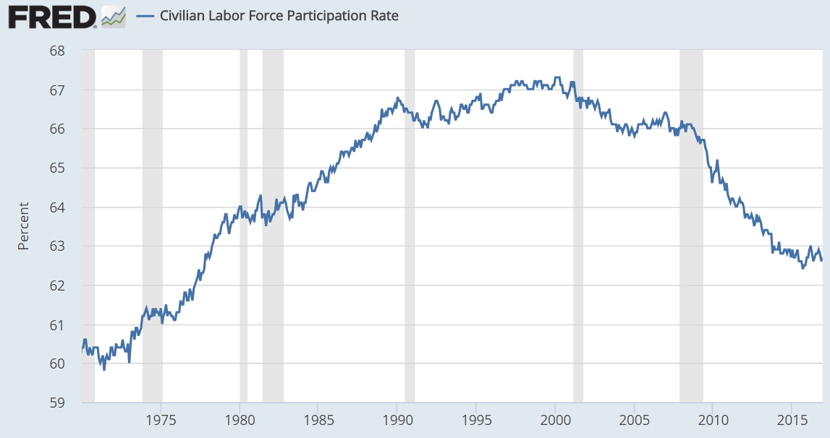
Why is labor force participation rate (LFPR) falling? We’ll answer that on the next page. Here is the trend:
2000
67.2%
2007
66.0%
-3.4%
62.6%
LFPR = Labor Force / Civilian Population
Nov ‘16: LFPR = 159.5m / 254.5m = 62.7%
Notes:
Want a job (not unemployed) means want a job but outside the labor force (discouraged or not looking). From 2007 to 2011, the crisis hit and many got discouraged. From 2011 -2015, they came back which actually helped the ratio.

Slide 3
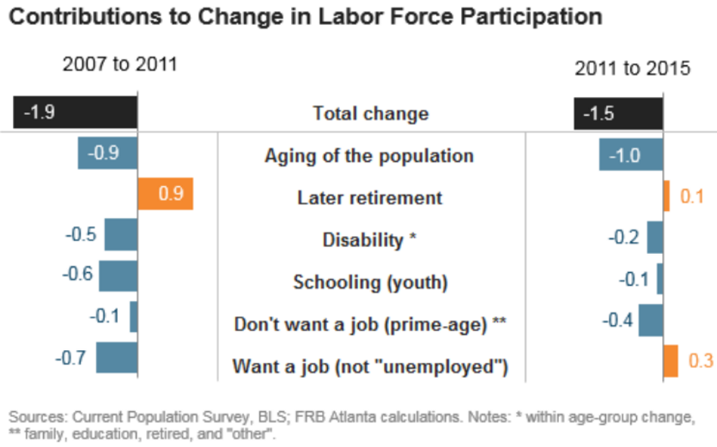
66.0
64.1
64.1
62.6
From 2007 to 2015, the LFPR fell by 3.4 percentage points.
From 2007-2011, delayed retirement offset the aging of the population. More in school and discouraged workers were due to the crisis.
From 2011 to 2015, aging was no longer offset by delayed retirement and many discouraged workers returned to the labor force.
So across the two periods, the net effect of discouraged workers is 0.4 of the 3.4 change.
Obamacare also allows more prime-age workers to get healthcare without working for a corporation (contributes to “don’t want a job” or reduces “later retirement” effect.)
For scale, a 1% change in the LFPR is about 2.5 million people.
%
Discouraged workers
Federal Reserve Bank of Atlanta “Labor Force Participation: Aging Is Only Half of the Story” (April 2016)
http://macroblog.typepad.com/macroblog/2016/04/labor-force-participation-aging-is-only-half-of-the-story.html
Notes:
Want a job (not unemployed) means want a job but outside the labor force (discouraged or not looking). From 2007 to 2011, the crisis hit and many got discouraged. From 2011 -2015, they came back which actually helped the ratio.

Slide 4
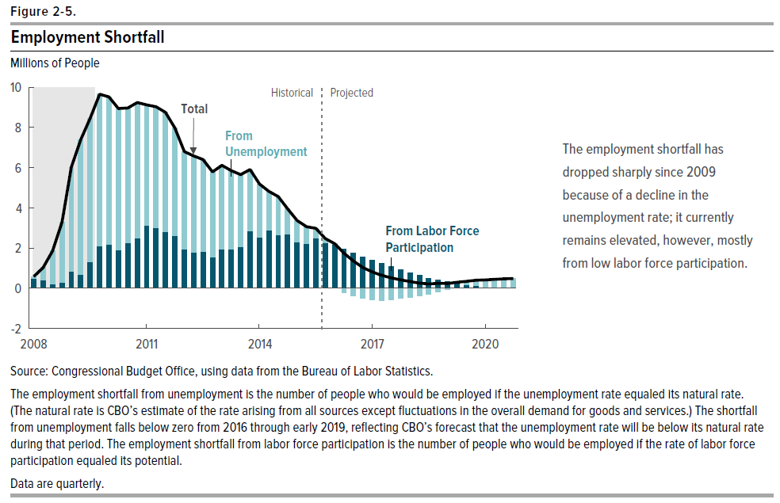
How far from full employment are we?
CBO estimated that as of December 2015 we were 2.5 million from full employment.
This number is down from nearly 10 million in 2010.
Primary reason at this stage is reduced labor force participation.
Source: CBO Budget & Economic Outlook 2016-2026
https://www.cbo.gov/publication/51129

Slide 5
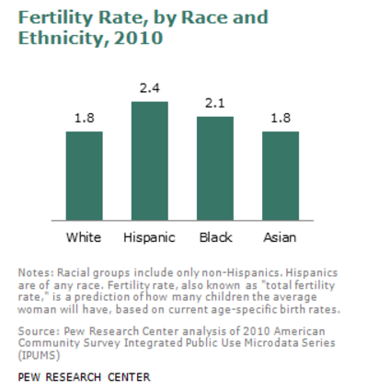
How do the fertility rates of various races compare?
“Hispanics are more than a quarter of the nation’s youngest residents, according to the new population estimates, accounting for 26.3% of the population younger than age 1. Among other major non-Hispanic groups, the share for whites is 49.6%; for blacks, 13.7%; and for Asians 4.4%.”
“The long-term result of these changes among younger age groups is that non-Hispanic whites are projected to become a minority of the population (47%) by 2050…Census Bureau projections say the change will occur in 2042.”
“Results from the 2010 Census showed that racial and ethnic minorities accounted for 91.7% of the nation’s growth since 2000.”
“The national median age in 2011 was 37.3.
Non-Hispanic whites have the oldest median age, 42.3, in 2011, according to the population estimates. Hispanics have the youngest, 27.6. Non-Hispanic blacks (32.9) and non-Hispanic Asians (35.9) also are younger than whites.”
Number of children the average woman is predicted to have in her lifetime.
Pew Center: Explaining Why Minority Births Now Outnumber White Births (May 2012)
http://www.pewsocialtrends.org/2012/05/17/explaining-why-minority-births-now-outnumber-white-births/

Slide 6
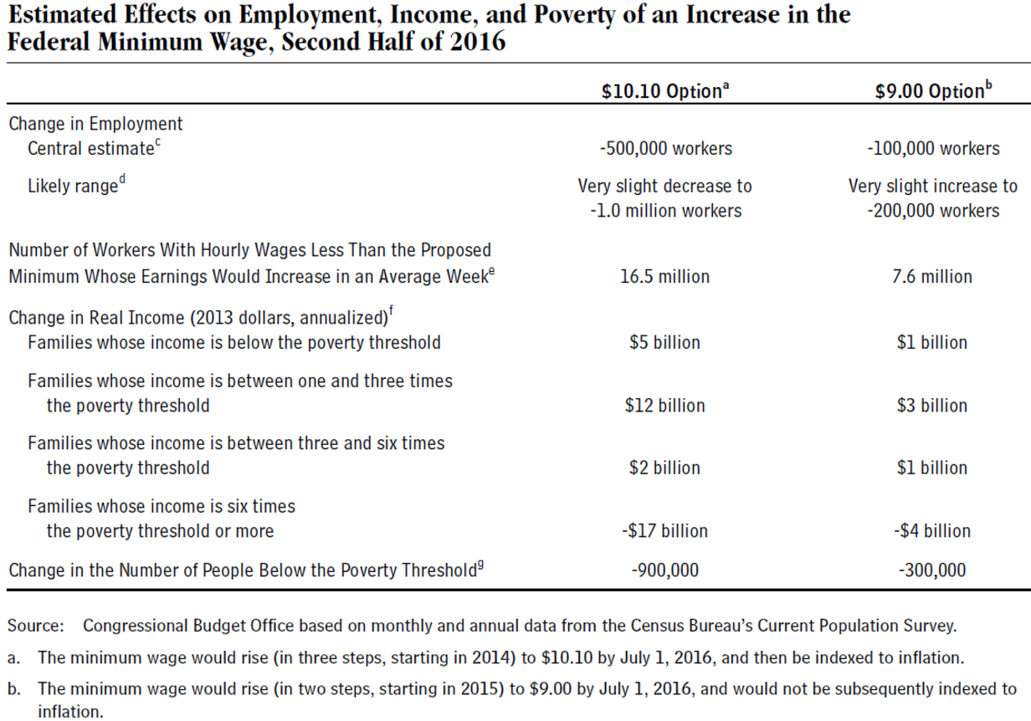
What are the economic effects of changing the minimum wage?
Raising the minimum wage:
Improves income inequality by shifting income from high-income households to lower-income households.
Reduces poverty rate
Likely increases unemployment rate
Source: CBO The Effects of a Minimum-Wage Increase on Employment and Family Income (February 2014)
https://www.cbo.gov/publication/44995
See also:
Paul Krugman “Raise that Wage” (Feb 2013)
http://www.nytimes.com/2013/02/18/opinion/krugman-raise-that-wage.html
Krugman’s view reflects an alternate view, which argues there may be no adverse jobs impact. Further links in his article.

