Slide 1
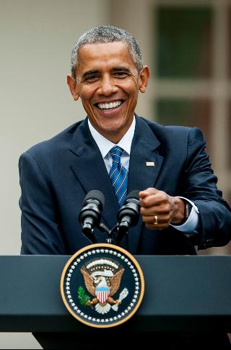
The Economy Under President Obama
David Doney & Karl Faulstich
NWSOFA Fiscal & Economic Discussion Group
March 21, 2017

Slide 2
Topics
Response to the Great Recession
Fiscal Policies / Budget
Economic Variables
Income Inequality
Appendix: ACA / Obamacare

Slide 3
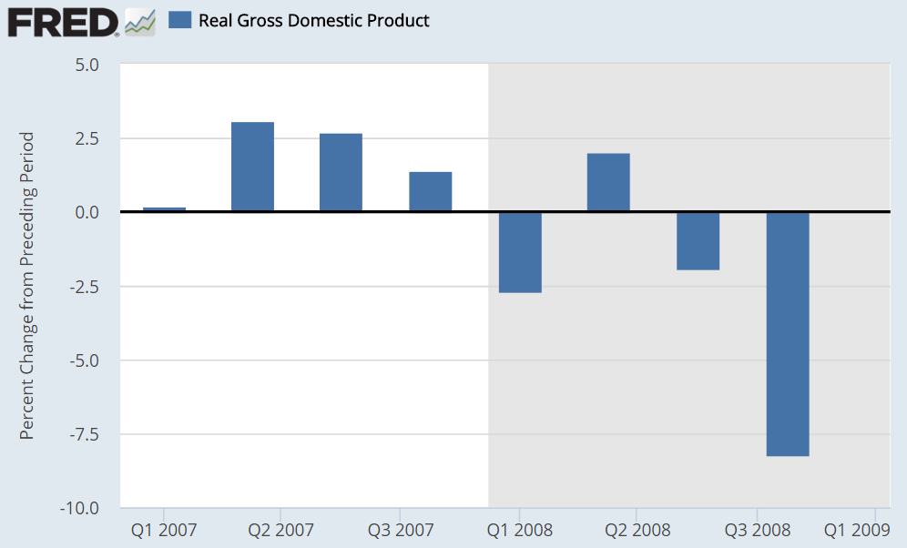
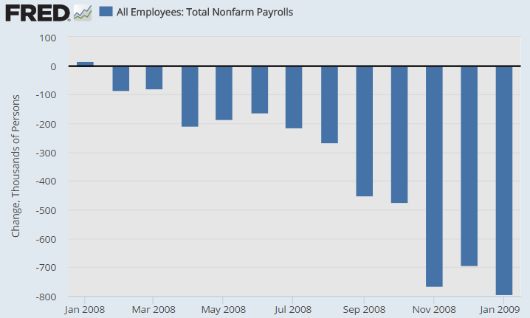
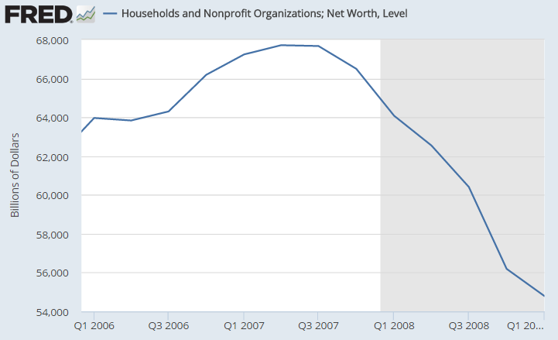
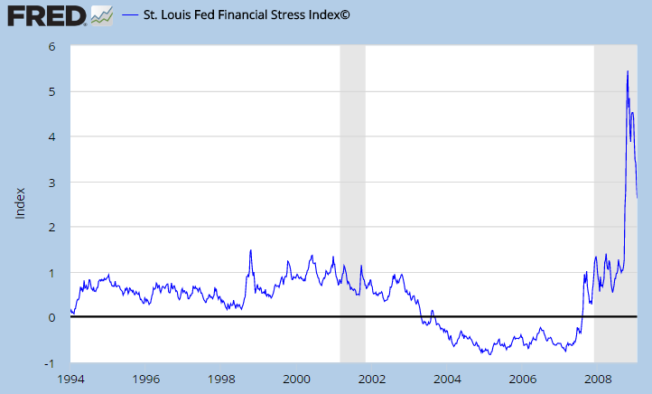
Real GDP
Jobs
2008
Losing 700k/mo.
Financial System
Stress
HH
Net Worth
$-12T / ~20%
Notes:
So you’re the President-elect and your economic team gives you the bad news…

Slide 4
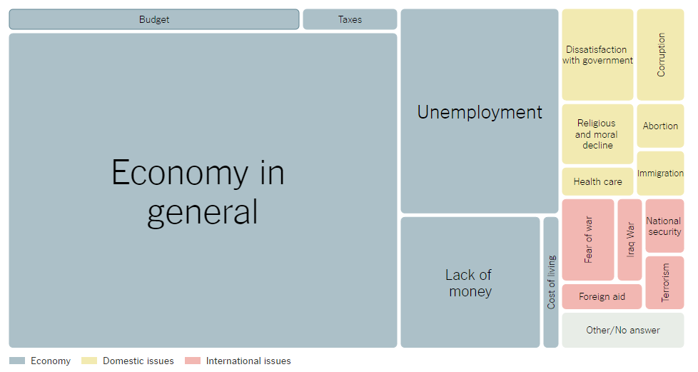
February 2009: Most Important Problem
Source: NYT / Gallup – “What do you think is the most important problem facing the country today?”
Notes:
Needless to say, people are focused on the economy to the exclusion of nearly all-else, despite the Iraq & Afghanistan wars

Slide 5
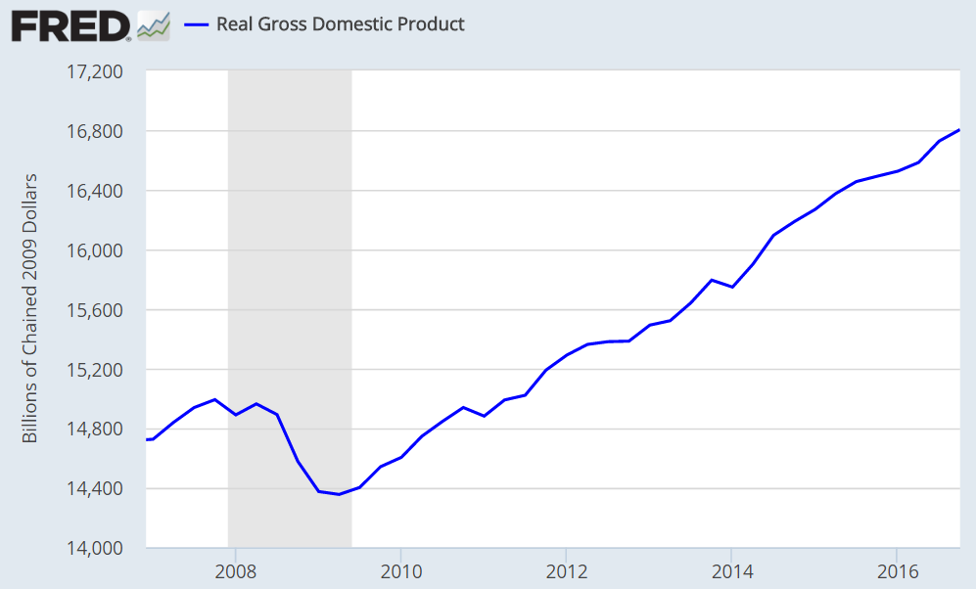
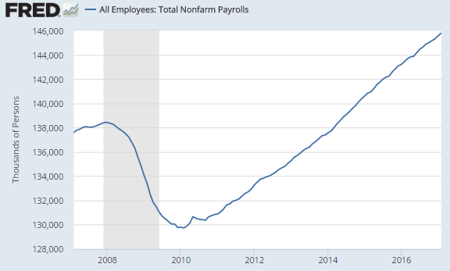
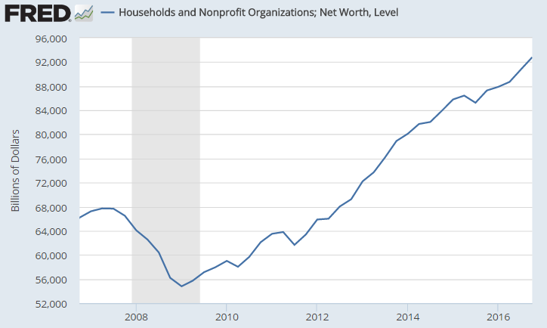
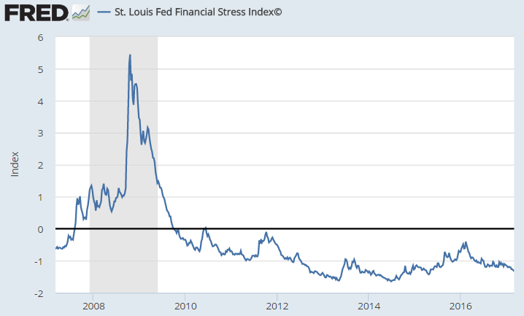
Real GDP
Jobs
+1.8T pre-crisis
+2.4T trough
+8m pre-crisis
+16m trough
Financial System
Stress
Household
Net Worth
+24T pre-crisis
+36T trough
Notes:
Economy on very solid ground in 2016

Slide 6
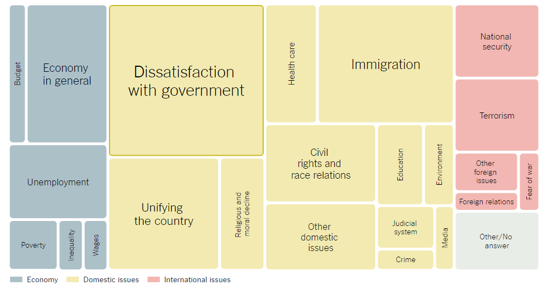
February 2017: Most Important Problem
Source: NYT / Gallup – “What do you think is the most important problem facing the country today?”
Notes:
Economy strong enough to where domestic/social issues are top of mind

Slide 7
Topics
Response to the Great Recession
Fiscal policies
Economic Variables
Income Inequality
Appendix: ACA / Obamacare
Notes:
So let’s roll back the clock to early 2009. Obama inaugurated January 2009 and has to address the Great Recession.

Slide 8
Economic Situation in December 2008
GDP
Jobs
Banks
Wealth
Down 4% in Q4 ‘2008 (revised to 8%)
Negative Q1, Q3 & Q4
Losing at ~700k/mo. rate
Monthly losses since May
Auto industry bailout
Stocks down ~50%
Housing down ~30%
Household net worth down $14 trillion or 20%
Banks on life support
Fed improvising
$11T committed; $3T invested
Data sources: FRED, CNN Bailout Tracker
Notes:
He’s facing both a serious recession and a financial market crisis. Fortunately, inflation is tame and he faces no Treasury borrowing constraints.
4 million foreclosures Sept ‘08 to Sept ’12; 6.5M by Sept 2014
11 million households “underwater” in 2011

Slide 9
Addressing the Crisis (Fiscal Policy)
Action | Implemented | Amounts & Explanation
Automatic Stabilizers / Safety Net | Automatic | About $300B/year deficit increase on average 2009-2012. Unemployment insurance, food stamps, Medicaid; and portion of revenue decline.
Bank Bailout / TARP | Bush (10/’08) | $700B auth; $313B disbursed; $294B paid back
Auto industry bailout / TARP | Bush & Obama | $80B in loans; $63B paid back
FDIC Bank Liability Guarantees (TLGP) | Bush (10/’08) | Temporary Liquidity Guarantee Program $1.5 trillion committed; $350B debt covered; fees exceeded defaults by ~$10B
Stimulus (ARRA) | Obama Feb ’09 | $787B initially; $832B revised.
Homeowner Refinancing / TARP | Obama Mar ’09 | $50B committed initially; $19B disbursed as grants so no repayment
Cash for Clunkers | Obama Jun ’09 | $3B
Dodd-Frank Act | Obama Jul ’10 | Significant banking regulation; minor budget impact
Sources: CNN Money.com’s Bailout Tracker; FDIC TLGP; CBO “The Effects of Automatic Stabilizers on the Federal Budget as of 2013” (March ‘13)
Politifact “Obama says automakers paid back all loans…” (January 2015)
CBO “Report on the TARP” (March 2016)
Notes:
Let’s take a look at the steps taken to address the crisis.
$11 trillion in commitments, $3 trillion invested. Not discussing Fed.

Slide 10
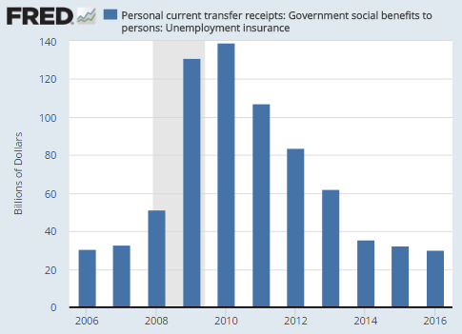
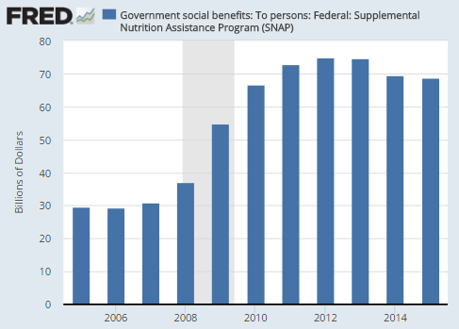
Automatic Stabilizers
Unemployment Insurance (Peak $140B)
Food Stamps / SNAP (Peak $75B)
Sources: FRED; CBO “The Effects of Automatic Stabilizers on the Federal Budget as of 2013” (March ‘13)
Notes:
Automatic stabilizers are automatic changes in revenues and outlays that are attributable to cyclical movements in real (inflation-adjusted) output and unemployment.

Slide 11
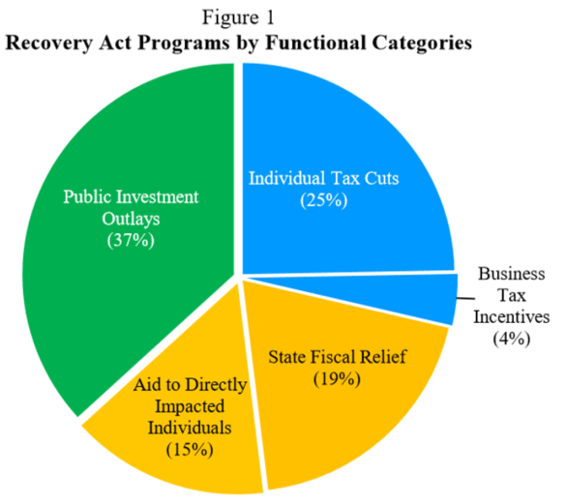
ARRA / Stimulus (February 2009)
Fiscal Year | Budget Deficit Impact ($Bil) | Real GDP % Increase | Unempl. Rate
2009 | $179 | 0.4 to 1.8 | -0.1 to -0.5
2010 | $401 | 0.7 to 4.1 | -0.4 to -1.8
2011 | $145 | 0.4 to 2.3 | -0.2 to -1.4
2012 | $47 | 0.1 to 0.8 | -0.1 to -0.6
2013 | $37 | 0.1 to 0.4 | 0.0 to -0.3
$809B from 2009 to 2013
$787B initial; $832B revised
Source: CEA – The Economic Impact of the ARRA Five Years Later – February 2014
CBO: “Estimated impact of the ARRA…” (Feb 2014)
Notes:
Public spending, tax cuts, and direct aid (to states and individuals) / About 1/3 each.

Slide 12
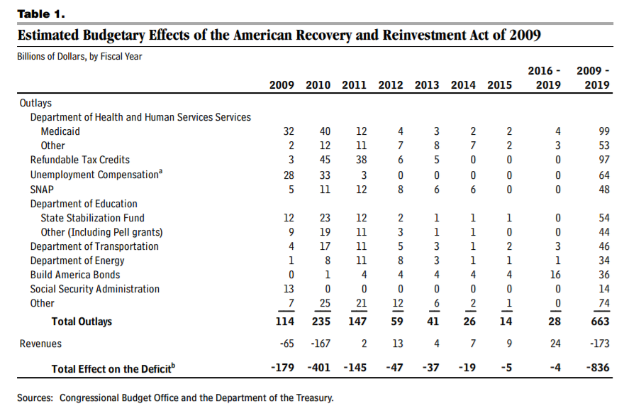
Stimulus Spending (ARRA)
Source: CBO “ESTIMATED IMPACT OF THE AMERICAN RECOVERY AND REINVESTMENT ACT ON EMPLOYMENT AND ECONOMIC OUTPUT IN 2014” (Feb 2015)

Slide 13
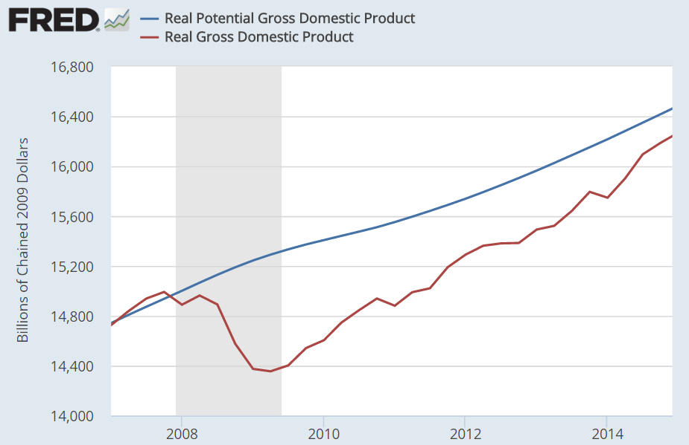
How Big Should Stimulus Be?
Potential GDP is an estimate of what the economy would produce at full capacity and employment
We faced a roughly “Trillion dollar hole” (output gap) in 2009
$430B
$900B
Ryan Lizza - The New Yorker: “Inside the Crisis” (October 2009)
Notes:
Wall Street Reform and Consumer Protection Act

Slide 14
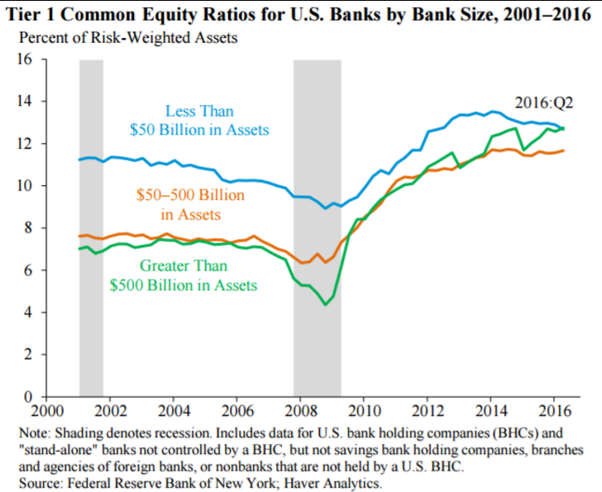
Dodd-Frank / Wall St. Reform & Consumer Protection Act (2010)
Limited bank risk taking
Regulates non-depository (shadow) banks and derivatives
Sets mortgage standards
Clarifies regulator roles & authority
Consumer Financial Protection Bureau
Fiduciary rule (broker must act in client’s best interest)
Volcker rule (limits bank ability to trade its own money)
Did not breakup the largest banks
Source: CEA; Economic Report of the President 2017
NYT: Trump moves to Roll Back Obama-Era Financial Regulations (Feb 3, 2017)
Notes:
Wall Street Reform and Consumer Protection Act

Slide 15
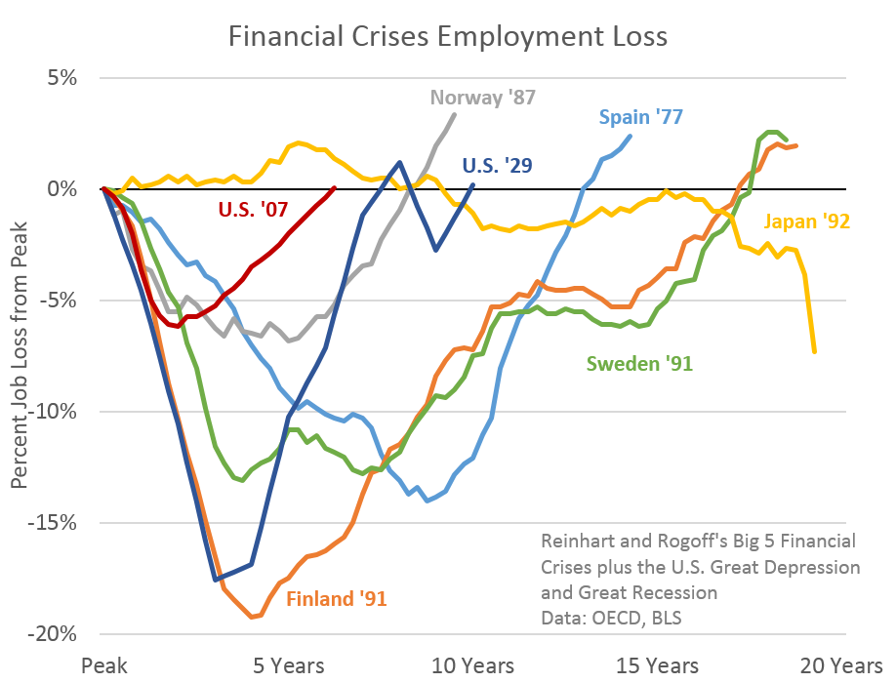
Pace of Recovery
Recession technically lasted December 2007 - June 2009
Recessions combined with financial crises have protracted recoveries, as households de-lever over an average 7 year period
U.S. non-farm employment recovered to pre-crisis peak by May 2014
Calculated Risk: “Employment Recovery: Great Recession…” (June 2014)
Washington Post: “Double Dip, or just one big economic dive?” (August 2011)
Notes:
Economist Carmen Reinhart stated in August 2011: "Debt de-leveraging [reduction] takes about seven years...And in the decade following severe financial crises, you tend to grow by 1 to 1.5 percentage points less than in the decade before, because the decade before was fueled by a boom in private borrowing, and not all of that growth was real. The unemployment figures in advanced economies after falls are also very dark. Unemployment remains anchored about five percentage points above what it was in the decade before.”

Slide 16
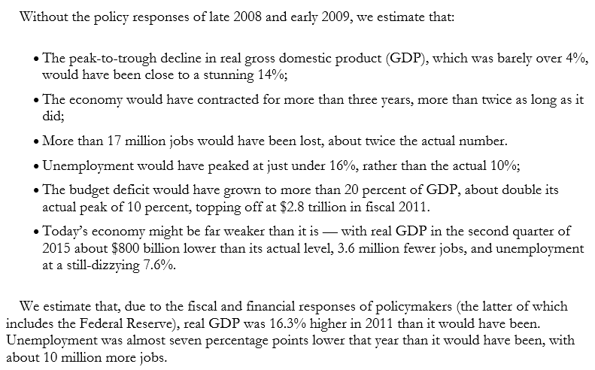
Impact of Policy Responses on Great Recession
Source: CBPP-Blinder and Zandi-The Financial Crisis: Lessons for the Next One (October 2015)

Slide 17
Topics
Response to the Great Recession
Fiscal policies
Economic Variables
Income Inequality
Appendix: ACA / Obamacare

Slide 18
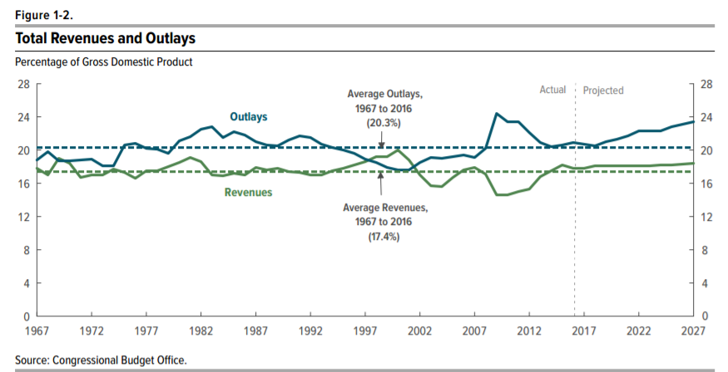
Historical average deficit ~3% GDP
Source: CBO Budget & Economic Outlook 2017-2027

Slide 19
Context for Budgetary Discussion
Presidents inherit a “budget trajectory” from their predecessors
  Reflected in CBO baseline forecast for next 10 years, published in January annually
Expenditures (“outlays”) rising as country ages (Medicare, Social Security)
  Spending increased an average of 5% each year 1990-2008
“Grand bargain” of tax hikes and mandatory program (SS, Medicare) reductions politically difficult
  Republicans have signed pledges not to raise taxes
  Democrats will not agree to mandatory program reductions without tax increases
Recessions add to deficits, as revenues fall and automatic stabilizer spending increases
Keynes: “The boom, not the slump, is the right time for austerity at the Treasury.”
  Reagan set post WW2 spending records 1981 - 1983 in $ and % GDP, until jobs recovered
The Obama budget story complicated by several factors
  Great Recession
  “Fiscal Cliff”

Slide 20
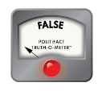
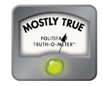
Obama & House GOP – January 29, 2010
Rep Jeb Hensarling (R)
“What were the old annual deficits under Republicans have now become the monthly deficits under Democrats. The national debt has increased 30 percent.”
“You are soon to submit a new budget, Mr. President. Will that new [FY2011] budget, like your old budget, triple the national debt and continue to take us down the path of increasing the cost of government to almost 25 percent of our economy?”
President Obama
“The fact of the matter is…that when we came into office, the deficit was $1.3 trillion [in 2009]…What is true is, we came in with $8 trillion worth of debt over the next decade."
Politifact: “Obama inherited deficits from Bush administration” (January 2010)
Politifact: Rep. Hensarling says annual deficits under Republicans have become monthly deficits under Democrats” (January 2010)

Slide 21
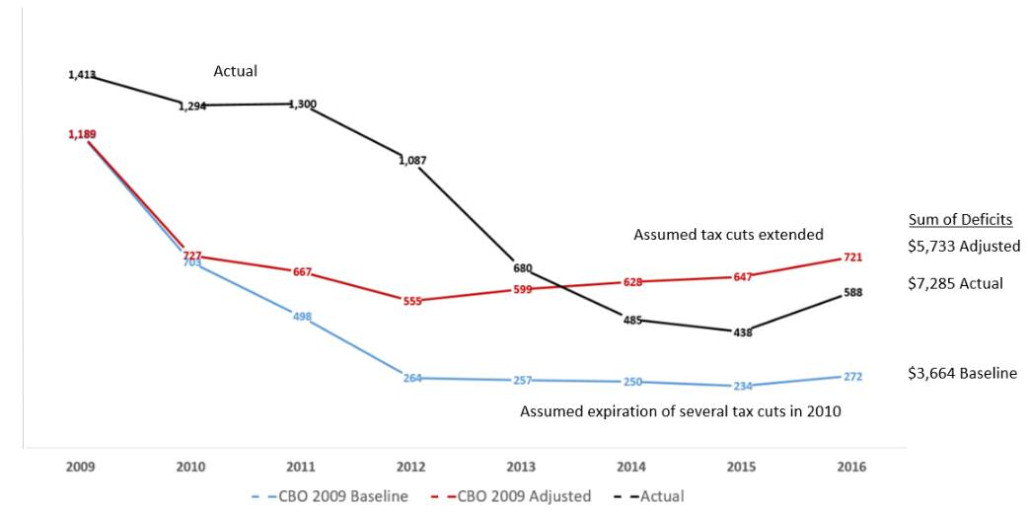
CBO Baselines & Deficit Trajectory ($Bil)
Note: 7 years, not 10
Source data: CBO Budget & Economic Outlook 2009 (Baselines: January 2009 / Actual: CBO Historical Tables 2016 & Oct 2016 monthly outlook)

Slide 22
Deficit Trajectory
Red line to black line
ARRA (All years)
Payroll tax cuts (2011-12)
Great Recession worse than expected
Blue line to red line
Extension of Bush tax cuts to 2013 for all and bottom 99% thereafter
Red to black
Sequester

Slide 23
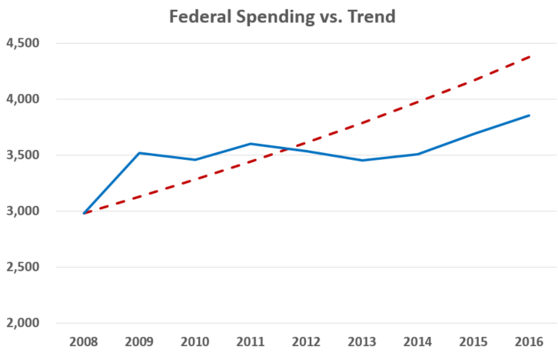
$Bil
5% Trend
Actual
Obama spent a bit less in 2014 than 2009!
Spending cuts ($) in 2010, 2012, 2013; hadn’t happened since 1965.
Probably slowed the recovery vs. more stimulus
Source data: CBO Budget & Economic Outlook 2017-2027
Federal spending increased ~5% annually on average from 1990-2008

Slide 24
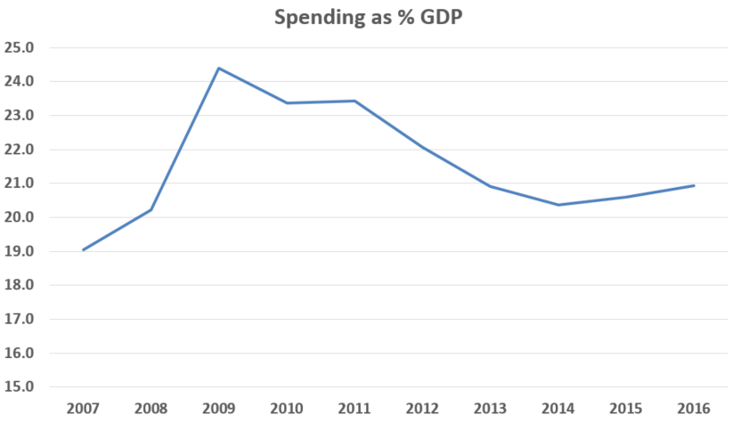
Employment did not recover pre-crisis level until 2014, yet spend as % GDP fell after 2009
Obama (2009-2016) = 22.0% GDP
Reagan (1981-1989) = 21.6% GDP
Clinton (1993-2000) = 19.2% GDP
Source: CBO Budget & Economic Outlook 2017-2027

Slide 25
Debt Ceiling Crisis & Sequester (BCA of 2011)
Republicans threatened to refuse to raise debt ceiling, risking debt default on August 2, 2011
  Obama: “manufactured crisis”
  McConnell: “A new template…[raising] the debt ceiling…will not be clean anymore.”
Budget Control Act signed into law August 2, 2011
  Debt ceiling raised to avoid default on debt
  Sequester initially planned to begin in early 2012 on discretionary (non-entitlement) spending
    About $920B in expense reduction over decade; $1.2T if Joint Committee unsuccessful
    Savings split between defense & non-defense discretionary spending
  Established “Joint Committee on Deficit Reduction” with $1.5T addnl. deficit reduction target
    Cmte. was not successful in reaching a budget deal, resulting in sequester enforcement
    Boehner and Obama came close to grand bargain, but both sides said taxes stopped deal
Sequester was delayed and then implemented as part of Fiscal Cliff resolution in 2013
S&P announced downgrade in U.S. credit rating August 7, 2011
Source: The Economist “No thanks to anyone” (August 6, 2011)
Source: Reuters “U.S. loses prized AAA credit rating from S&P” (August 7, 2011)

Slide 26
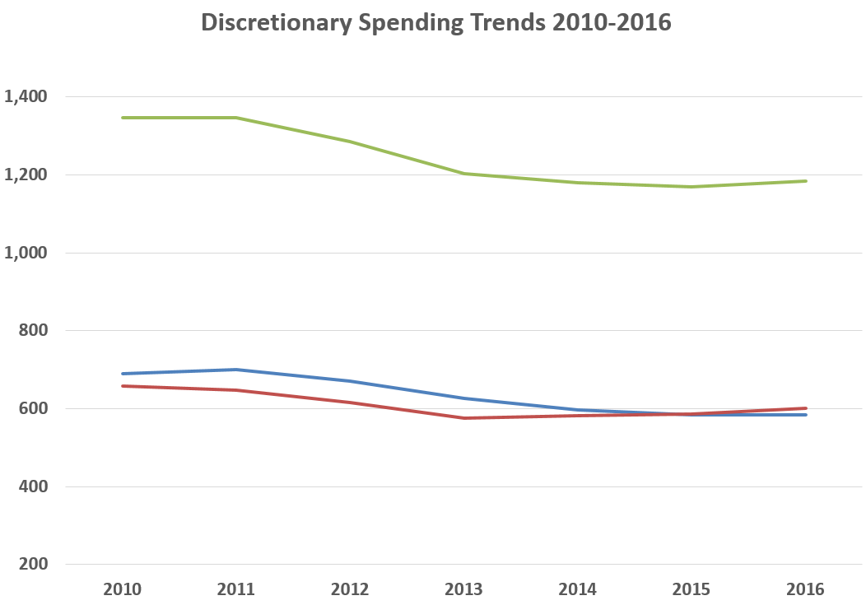
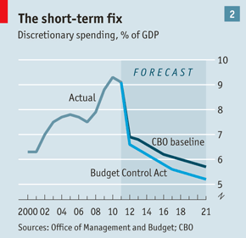
Sequester Impact / BCA 2011
$ Bil
Total
Defense
Non-Defense
Source: The Economist “No thanks to anyone” (August 6, 2011)

Slide 27
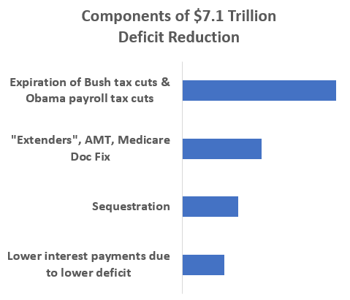
Fiscal Cliff (Beginning 2013)
The “Fiscal Cliff” described a scenario in which significant tax increases and moderate spending cuts would take effect in 2013 if laws already on the books were not changed (i.e., no action by Congress)
Tax hikes and spending cuts would reduce future deficits & debt by up to $7.1 trillion over a decade, but increased risk of recession
President could have vetoed any attempt to avoid significant deficit reduction
American Taxpayer Relief Act of 2012 (ATRA) partially avoided the cliff. Bush tax cuts allowed to expire for top 1% and sequester implemented.
$3.3T
$1.7
$1.2
$0.9
CBO: An Update to the Budget and Economic Outlook: Fiscal Years 2012 to 2022 (August 2012)
Washington Post: E.J. Dionne – Why doing nothing yields $7.1 trillion in deficit cuts
Notes:
$3.3T from letting temporary income, payroll and estate tax cuts enacted in 2001, 2003, 2009, and 2010 expire on schedule at the end of 2012;
$1.2T from letting the sequestration of spending take effect (i.e., implementing the Budget Control Act of 2011);
$1.7T related to temporary tax cut expirations typically extended (“extenders”), no longer applying Medicare “Doc Fix”, allowing AMT to impact more taxpayers
$0.9T in lower interest payments on the debt

Slide 28
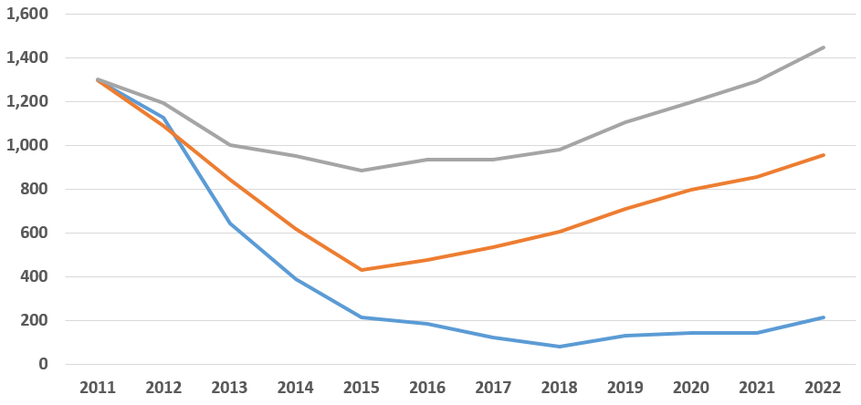
Deficit Paths Before & After ATRA ($ Bil)
Total Deficits
2013-2022
$10,731
Before: “Avoid Cliff Entirely”
Avoid both tax hikes and spending cuts
March 2012 Alternative Baseline
$6,825
After: “Partially Avoided Cliff”
February 2013 Baseline
Before: “Go Over Cliff”
Tax hikes and spending cuts
August 2012 Baseline
$2,258
Source data: CBO Budget & Economic Outlook – Baselines for March 2012 (Alt Scenario), August 2012 and February 2013

Slide 29
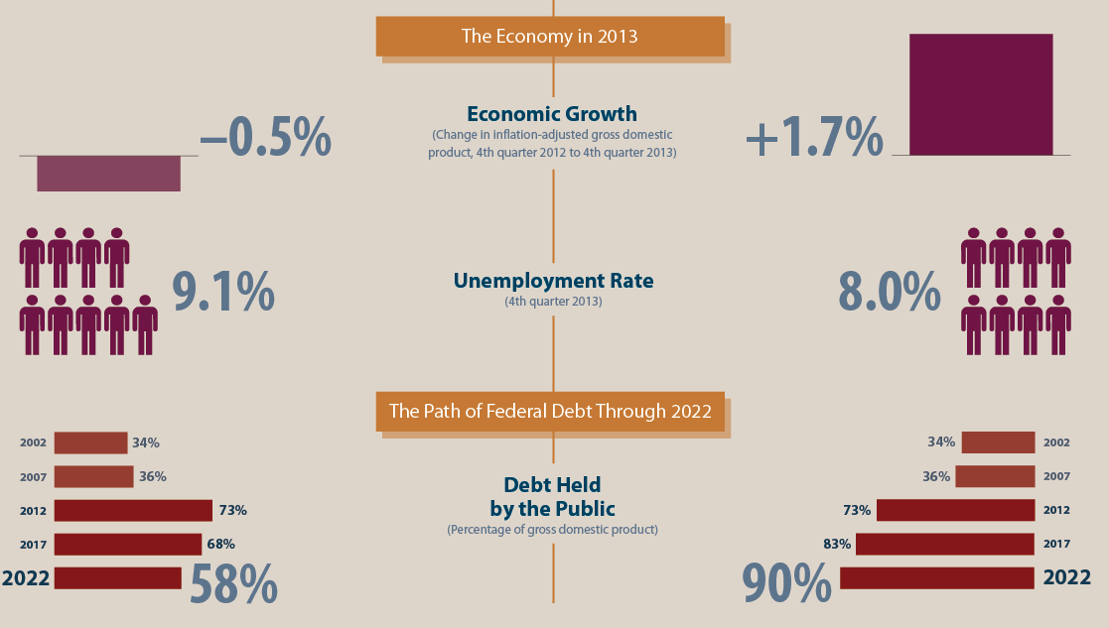
Go Over the Cliff (Cut Deficit)
Avoid Cliff (Status Quo)
CBO: An Update to the Budget and Economic Outlook: Fiscal Years 2012 to 2022 (August 2012) [See infographic]

Slide 30
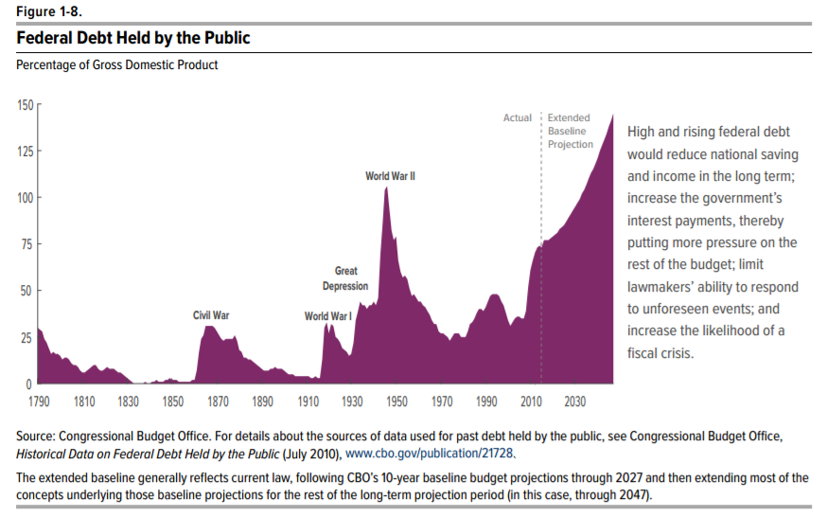
So How Much Did Obama Add to the Debt?
Debt held by the public
9/2008: $5.8T / 39.3% GDP
9/2016: $14.2T / 77.0% GDP
Change: $8.4T
Sum of deficits ‘09-’16: $7.3T
“Debt held by the public” is the primary debt measure used by CBO and many other economists
Add the “Intra- governmental debt” to get to the “National debt”
Source: CBO Budget & Economic Outlook 2017-2027

Slide 31
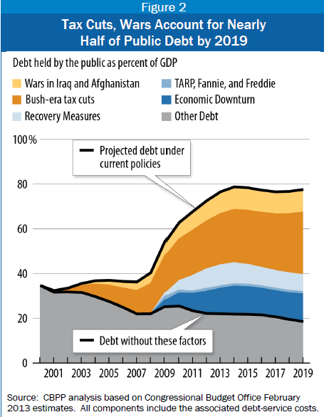
How much did Obama add to the debt?
Actual sum of deficits: $7.3 T
  Overstated as inherited a deficit trajectory
Actual vs. 2009 baseline comparison
  $7.3T actual - $3.7T baseline = $3.6T
  Overstated as impact of economy worse than CBO anticipated in 2009 baseline
Policy-specific: $2.25 T
  ARRA = $850B
  Extend Bush tax cuts fully ‘11-’12 = $600B
  Payroll tax cuts 2011-2012 = $200B
  Extend 80% Bush tax cuts ‘13-16 = $950B
  Less: Sequester ‘13-16 = ($350B)
Long-run
  Extension of 80% Bush tax cuts: +1.5% GDP or about $240B/year today
Source Data:
CBPP “Economic Downturn and Legacy of Bush Policies Continue to Drive Large Deficits” (February 2013)
Washington Post – Ezra Klein “Doing the Math on Obama’s Deficits” (January 2012)

Slide 32
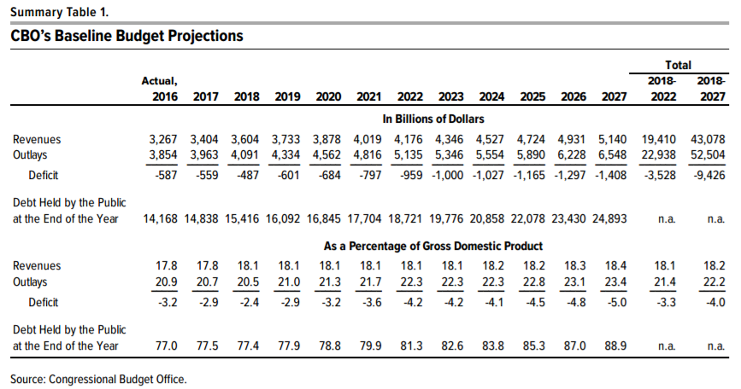
What Baseline Did Obama Leave for Trump?
Over a decade, if Trump changes nothing:
Deficits should fall through 2018
Debt held by the public rises by $10.7 trillion, from $14.2 T to $24.9 T
Debt held by the public rises from 77% GDP to 89% GDP
Annual deficits rise towards 5% GDP
CBO Budget & Economic Outlook 2017-2027 (January 2017)
Can Trump and Congress improve this baseline?
With a booming economy, now is the time…

Slide 33
Topics
Response to the Great Recession
Fiscal policies
Economic Variables
Income Inequality
Appendix: ACA / Obamacare

Slide 34
Economic Trends 2007-Present
GDP level
# Employed
U-3 rate
Wealth
Today
2007
Bubble
Peak
Income (?)
U-6 rate
LFPR (prime)
2008
2011 to 2014
2009 or 10
Obama
Inaugurated
January 2009
Notes:
When analyzing economic variables during the Obama era, they tended to follow this pattern. Understand the starting point for the figures quoted.

Slide 35
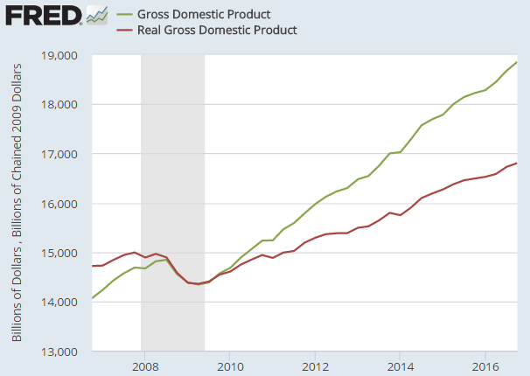
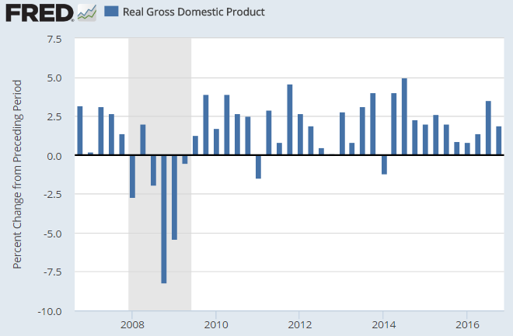
GDP
$18.9T
$16.8T
Real GDP in chained 2009 dollars
Real GDP fell $650B pre-crisis peak to trough about 5%
Roughly $5,000 per family
Real GDP growth averaged ~1.8% across 8 years
  2.2% avg. since end of Recession
Initial reading on GDP for Q4 ‘08 was -4% but revised to -8%
  May have impacted size of stimulus

Slide 36
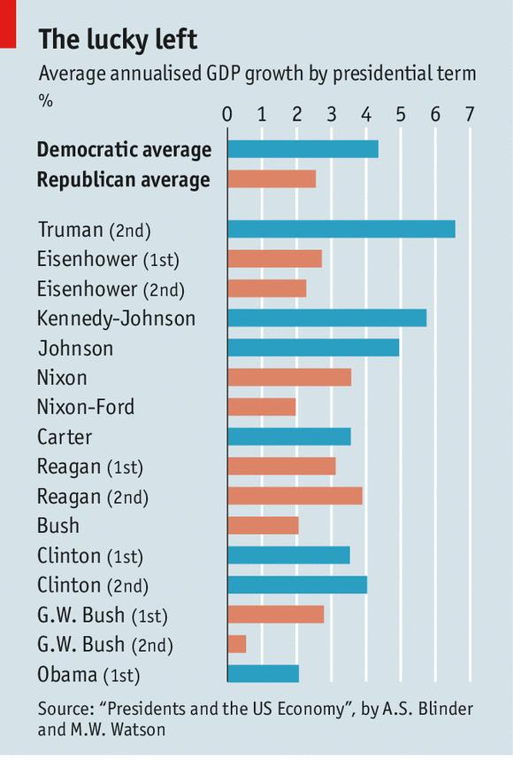
Historically the economy has grown faster under Democratic Presidents
Bill Clinton 2012: “Since 1961…the Republicans have held the White House 28 years, the Democrats 24…In those 52 years, our private economy has produced 66m private-sector jobs. So what’s the jobs score? Republicans 24m, Democrats 42[m].”
Source: The Economist: “Timing is Everything” (August 2014)

Slide 37
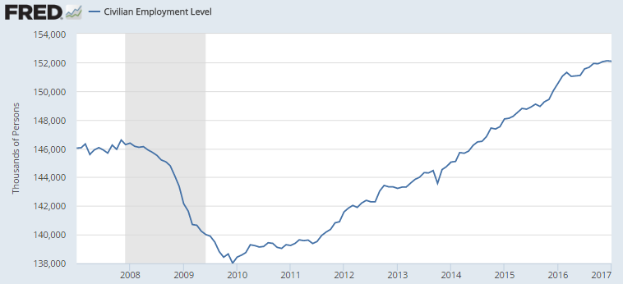
Civilian Employment
152.1M
+7%
146.6M
138.0M

Slide 38
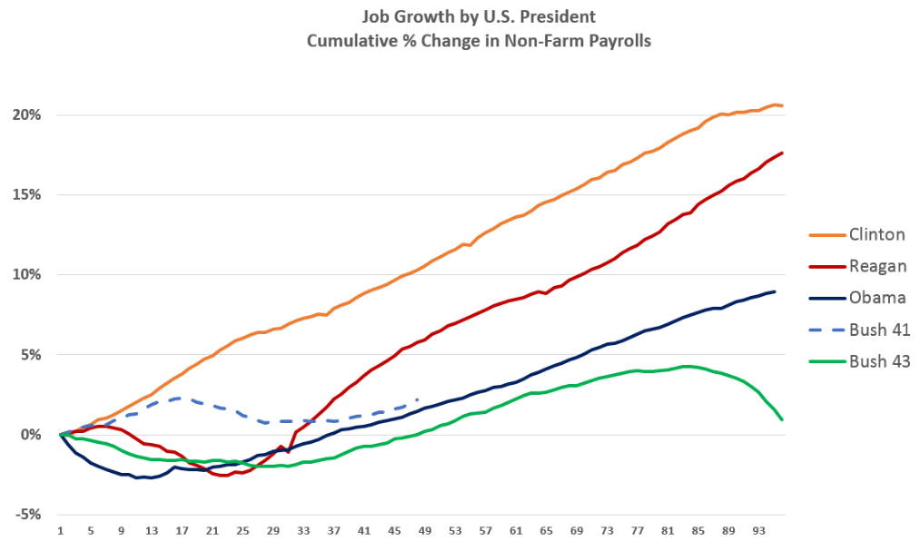
Source data: FRED Non-farm payrolls (PAYEMS)

Slide 39
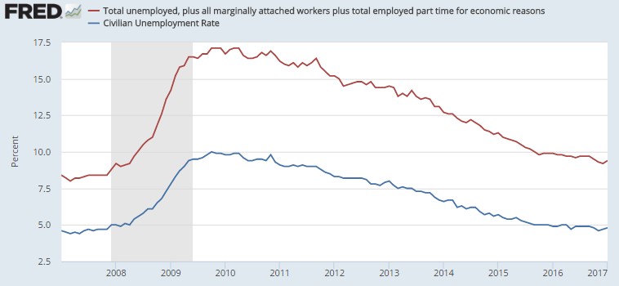
Unemployment Rate
U-6
U-3

Slide 40
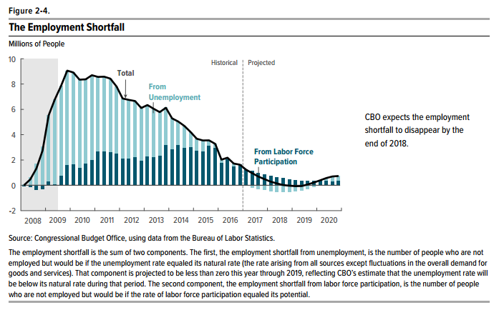
Employment Shortfall
About 2 million as of 12/31/16
About 2.5 million at 12/31/15

Slide 41
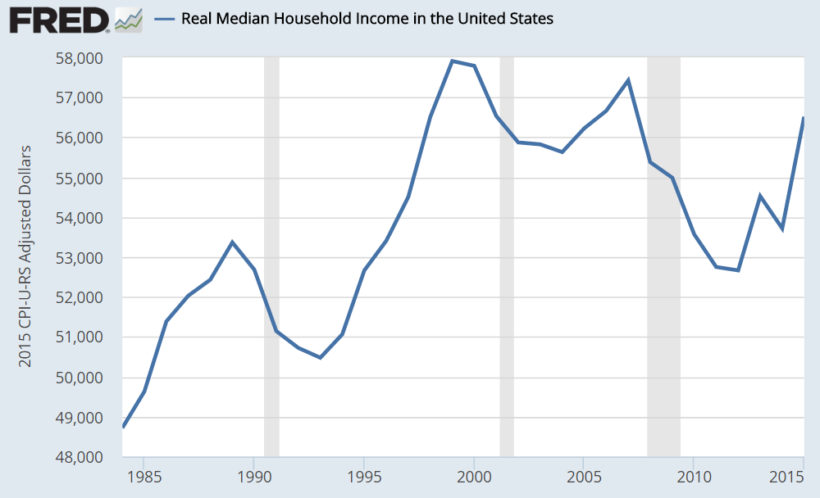
Household Income (1985-2015*)

Slide 42
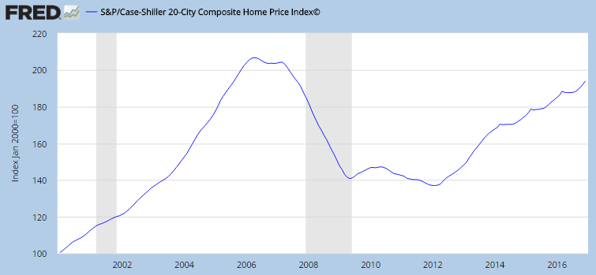
Housing Prices

Slide 43
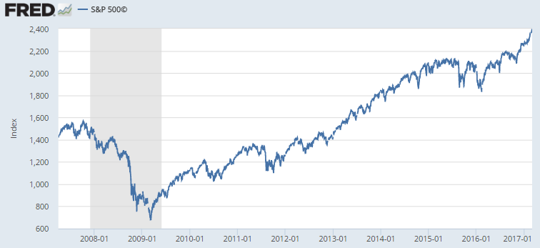
Stock Market: S&P 500
2,238 on 12/30/16
8.6 million jobs lost (6%)
Nov 2007 – Dec 2009
1,565 on Oct 9, 2007
676 on March 9, 2009
Notes:
2238 12/30

Slide 44
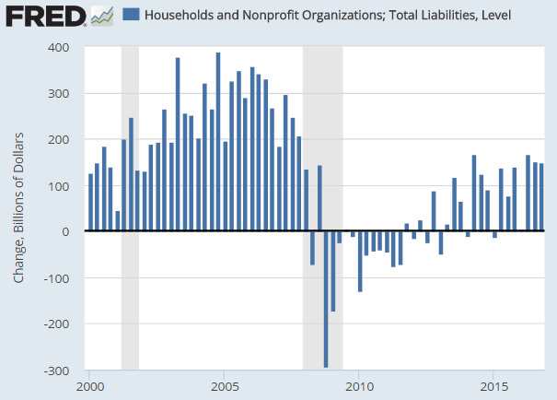
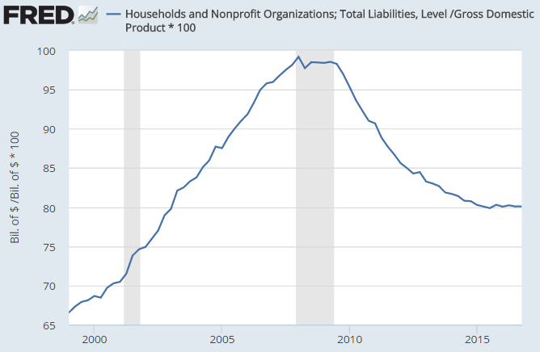
Household Debt
$ Changes by Quarter
% GDP
Nearly $7.5 trillion in household debt added Q1 ’00 to Q4 ’07, from $6.9T to $14.4T
Regained Q3 2008 peak $14.6T in Q3 2015
Households “de-leveraging” (paying off debt) a significant headwind during the Obama era

Slide 45
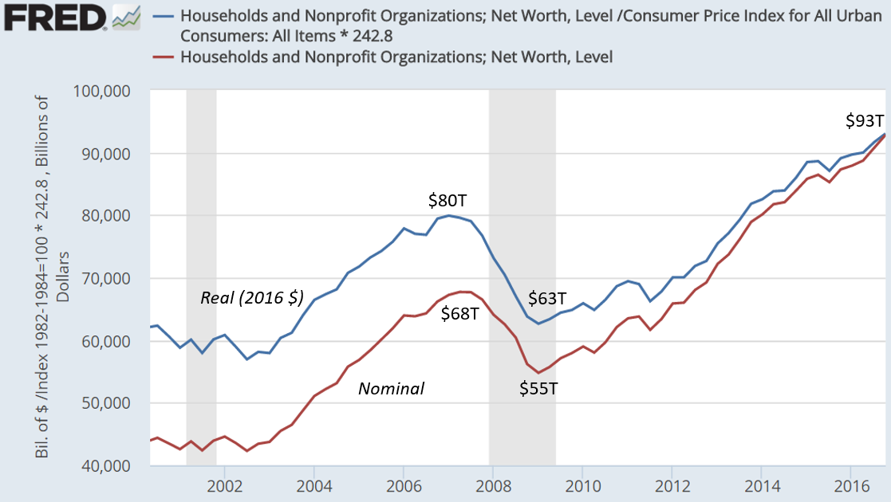
Household Net Worth 2000-2016
Our economy is a tremendous wealth engine…but the distribution is highly uneven.
The top 1% had 42% of the wealth in 2015, vs. 36% in 2007 and 24% in 1979
$93 trillion is about $700,000 / household on average, but bottom 50% average $11,000

Slide 46
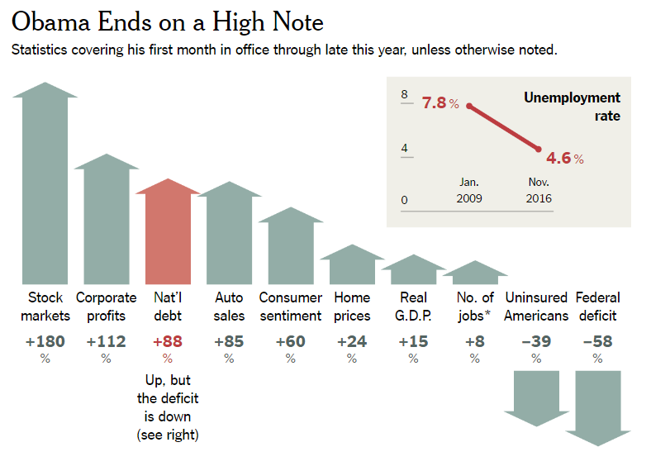
Source: NYT Steve Rattner - 2016 in Charts

Slide 47
Topics
Response to the Great Recession
Fiscal policies
Economic Variables
Income Inequality
Appendix: ACA / Obamacare

Slide 48
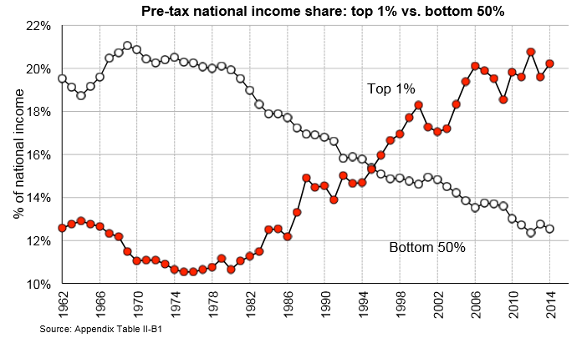
Income Inequality Trends
20%
At 1979 levels of income inequality, the bottom 80% of families would have $11,000 more per year in income.
U.S. is 30th percentile globally on income inequality.
12%
Source: Piketty, Saez, Zucman: Distributional National Accounts (Nov 2016)
Larry Summers “It can be morning again for the world’s middle class” (FT / January 2015)
Notes:
If there are 100 families in the U.S., the richest 1 family has $20. The other 99 families have $80 spread among them.

Slide 49
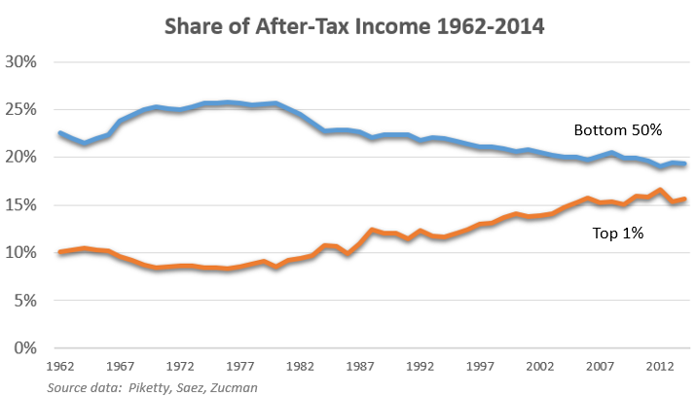

Slide 50
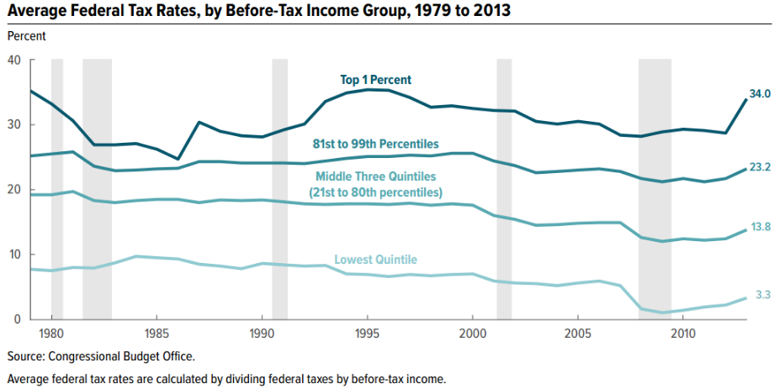
2013: Obama allows Bush tax cuts to expire for top 1%
CBO: The Distribution of Household Income and Federal Taxes, 2013
Notes:
Clinton tax hikes in the 1990’s reversed by Bush tax cuts; which were allowed to expire for top 1%.

Slide 51

After-tax
ACA reduces after-tax income inequality by raising taxes on the top 5% and providing subsidies to lower-income persons. This chart also includes effect of letting Bush tax cuts expire for the top 1%.
Pre-tax
Efforts to raise federal minimum wage blocked
Union membership rates continued falling
Infrastructure stimulus reduced and delayed until late 2015
Overtime regulations blocked

Slide 52
Topics
Response to the Great Recession
Fiscal policies
Economic Variables
Income Inequality
Appendix: ACA / Obamacare

Slide 53

Joe, how big a deal is this?
March 23, 2010

Slide 54
ACA / Obamacare Summary
20+ million covered via exchanges and Medicaid expansion
Uninsured rate fell from 16% in 2010 to 9% by 2016
Guaranteed issue: Prohibits discrimination based on pre-existing conditions
Provides subsidies for lower income individuals (~10 million)
Individual mandate: All persons must have insurance or pay penalty
Employer mandate: Businesses with > 50 employees provide or pay
Persons under 26 years old can be covered by parent’s insurance

Slide 55
ACA / Obamacare Summary
Raised taxes on top ~5% highest-income persons (>$200k/$250k Married)
Reduces federal budget deficit moderately over time
Minor economic impact due to slightly smaller workforce
Funding for many cost-related pilot programs and studies
Individual elements are very popular, except mandate
Insurers leaving exchanges may put program at risk (CBO believes stable)
Under sustained attack by Republicans (e.g., risk corridor program)
Saves between 20,000 – 45,000 lives per year

Slide 56


…
Source data: CBO “Federal Subsidies for Health Insurance Coverage for People Under Age 65: 2016 to 2026” (March 2016)
Notes:
9m federal exchange, 3m other states with their own exchanges

Slide 57

Prices for 40-year old non-smoker making $30,000 / year
Kaiser Family Foundation – 2017 Premium Changes and Insurer Participation in ACA Health Insurance Marketplaces
October 2016

Slide 58

Employer market price increases unaffected or possibly reduced by Obamacare

Slide 59

In June 2015, CBO forecasted that repeal of ACA would increase the deficit by $137 billion - $353 billion over the 2016-2026 period, depending on economic feedback effects
Source: CBO “Budgetary and Economic Effects of Repealing the ACA” (June 2015)

Slide 60
Economic Impact
CBO estimated in June 2015 that repealing the ACA would:
Decrease aggregate demand (GDP) in the short-term
  Low-income persons who tend to spend a large fraction of their additional resources would have fewer resources (e.g., ACA subsidies would be eliminated).
  This effect would be offset in the long-run by the labor supply factors below.
Increase the supply of labor and aggregate compensation by about 1% over the 2021-2025 period.
Remove subsidies (disincentives to work), encouraging workers to supply more hours of labor.
  Increase the total number of hours worked by about 1.5% over the 2021-2025 period.
Remove the higher tax rates on capital income
  Encouraging additional investment, raising the capital stock and output in the long-run
Source: CBO “Budgetary and Economic Effects of Repealing the ACA” (June 2015)

Slide 61
Comparison with Republican Plan
ACA / Obamacare | Republican Plan / AHCA | Commentary
Individual mandate & penalty | No mandate. If let insurance lapse, pay 30% penalty in first year back | Incentive to stay, but dis-incentive to return. More young people will likely go uninsured, raising costs for all.
Business mandate to offer insurance if > 50 employees | Repealed | Favors business over labor
Premium subsidies based on income, local cost & age | Age-based subsidies phased out for higher incomes | More young people will opt-out
“Cost-sharing subsidies” for out-of-pocket expenses | Repealed in 2020 | Reductions in benefits for poor; deficit reduction; worsens after-tax inequality
Tax hikes on higher incomes | Repealed | Top 1% pay $33k/year less in taxes
No denial of coverage for pre-existing conditions | Maintained | Status quo
Dependent coverage to 26 | Maintained | Status quo
Essential health benefits | Maintained | Status quo
Insurers cover % cost of care | Repealed | Enables catastrophic plans
61

Slide 62
Comparison with Republican Plan
ACA / Obamacare | Republican Plan / AHCA | Commentary
Medicaid expansion at 138% of poverty level | Status quo through 2019, then expansion costs state more | Fewer states will keep expansion.
Medicaid costs open-ended for eligible persons (70+ mil) | Per-capita cap starting 2020; amount at 2016 level | Reductions in benefits for poor; deficit reduction; worsens after-tax inequality
Funding for planned parenthood clinics via Medicaid & other programs | Repealed for one year | Reductions in benefits for poor; deficit reduction; worsens after-tax inequality
Plans that qualify for subsidies | Expanded | More choices
Health savings accounts ($3,400 indiv, $6,750 family) | About 2x more can be put into account pre-tax | Do poor people have any more to save? Primarily benefits wealthy.
Premiums for older persons capped at 3x young | Older premiums capped at 5x young; states can set own ratio | Older will pay more; more likely to opt-out leaving healthier pool at lower cost
Lifetime limits prohibited | Maintained | Status quo
Limit exec pay deduction | No limit | Tax break for corporations
Sources:
62

Slide 63


Slide 64


Slide 65
CBO Scoring of the Republican Bill (AHCA)
Coverage reduced: 14 million in 2018, 21 million in 2020, and 24 million in 2026
  Uninsured rate rises from around 10% to 19%
Reduces deficit $337 billion over a decade
  Spend ~$1.2 trillion less, collect $900B less
  Medicaid spending cut $880B over a decade due to fewer recipients
  Taxes on roughly the top 5% of income earners cut, along with penalties
Insurance premiums would rise initially relative to current law, but would be reduced later:
  Healthier pool as cost increases for older persons force some out
  Plans that cover a lower % of healthcare costs, on average
  Reinsurance programs established by the law help reduce premiums
Under both current law and the AHCA, CBO assumes the health exchange marketplaces would remain stable (i.e., no "death spiral")
Notes:
"Starting in 2020, the increase in average premiums from repealing the individual mandate penalties would be more than offset by the combination of several factors that would decrease those premiums: grants to states from the Patient and State Stability Fund (which CBO and JCT expect to largely be used by states to limit the costs to insurers of enrollees with very high claims); the elimination of the requirement for insurers to offer plans covering certain percentages of the cost of covered benefits; and a younger mix of enrollees. By 2026, average premiums for single policyholders in the nongroup market under the legislation would be roughly 10 percent lower than under current law..."

Slide 66


Slide 67

- spend less
+ spend more or collect less

Slide 68

The Economy Under President Obama
David Doney & Karl Faulstich
NWSOFA Fiscal & Economic Discussion Group
March 21, 2017

Slide 69

Big Numbers…What Do They Mean?

Slide 71

2009-2016
$4,111B Base
$ 871B OCO
$4,981B Total
Source: Defense Budget Overview – FY 2017 US. DOD FY2017 Budget Request

