Slide 1
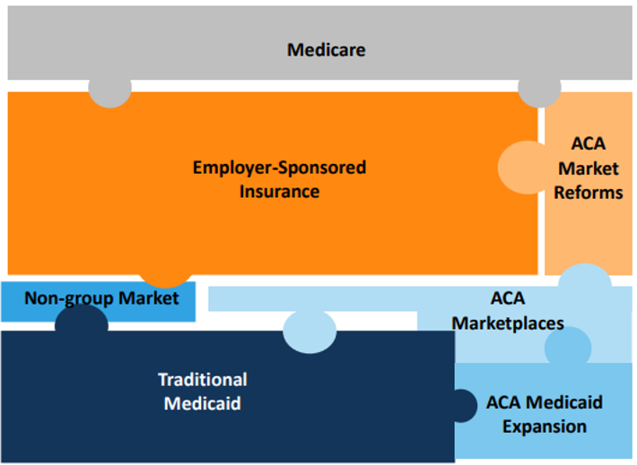
Healthcare Reform: Next Steps
David Doney
Keith Moens
Karl Faulstich
August 2017

Slide 2
Healthcare Reform
Current State
Sabotage Efforts
Republican Legislative Proposals
Short-term Fixes
Long-term Fixes

Slide 3
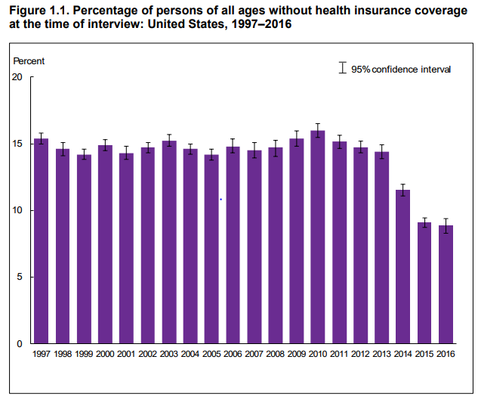
ACA Has Significantly Reduced the Uninsured
Uninsured Under Age 65
Measure | 2010 | 2016 | Chg.
% Uninsured | 17.3 | 9.0 | -8.3
# Uninsured (millions) | 48.2 | 28.2 | -20.0
17.3%
9.0%
Source: CDC FastStats / 2016 National health Interview Survey (May 2017)

Slide 4
Sources of Health Insurance Coverage in 2016 (Millions of Persons)
Employer-Based
155
Other Coverage
90
Uninsured
27
Medicaid & CHIP
57
ACA Medicaid
11
ACA Exchange
12
Other
10
Population
325
Under 65 yrs.
272
65+ yrs.
Medicare
53
Sources: CBO, Kaiser Family Foundation

Slide 5
ACA Structure
Subsidies
Mandates
Medicaid Expansion
Community Rating & Guaranteed Issue
Help lower-income persons buy insurance
Premium tax credits
Cost-sharing reduction (CSR) payments
Mandate all have insurance
Individual
Employer
Limit discrimination
Pre-existing conditions
Older can be charged 3x younger enrollees
Further expand coverage
31 states + DC expanded
19 have not

Slide 6
ACA Results
20+ million covered via exchanges and Medicaid expansion
Uninsured rate fell from 16% in 2010 to 9% by 2016
Improved income inequality (taxes on top 5% fund subsidies to lower-income persons)
Reduces budget deficit moderately
Saves 20-45k lives per year
Persons under 26 years old can be covered by parent’s insurance
Minor economic impact due to slightly smaller workforce
Exchanges remove the “corporate tether”
Provided funding for many cost-related studies
Individual elements very popular, but not the mandate

Slide 7
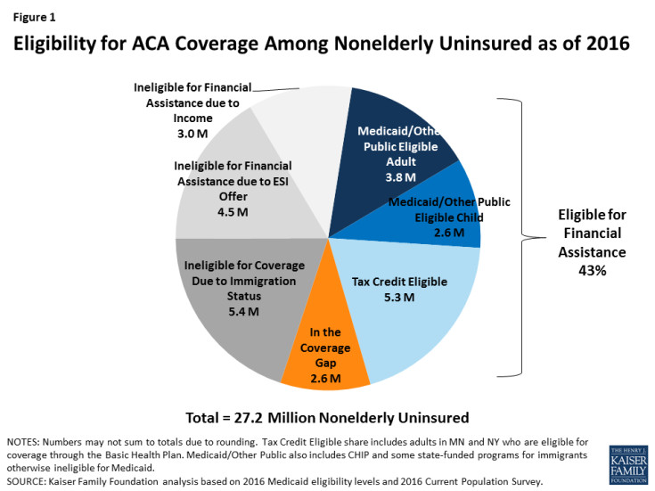
Who are the Uninsured?
Who are the 27m uninsured < 65 yrs?
3.8m – Adult eligible for Medicaid
2.6m – Children eligible for Medicaid
5.3m – Eligible for subsidies
2.6m – Coverage gap where income above Medicaid limit but below threshold for subsidies (~44% to 100% poverty) in states without expansion
5.4m – Undoc. immigrants (<65 yrs.)
4.5m – Employers insurance offer (ESI) not taken
3.0m – Income too high for assistance
Other facts
46% cite cost as a barrier
Nearly 12 million are eligible for ACA financial help either via Medicaid expansion or the exchanges
Kaiser: “Estimates of Eligibility for ACA Coverage among the Uninsured in 2016” (October 2016)
Kaiser: “Key Facts about the Uninsured Population” (September 2016)
Notes:
The number of undocumented immigrants is around 11 million total; this estimate is for those under 65 (Non-elderly)
ESI offer = Employer sponsored insurance (ESI) offered by employer (but refused)
So 46% cite cost as a barrier. Let’s look at that at costs in todays markets.

Slide 8
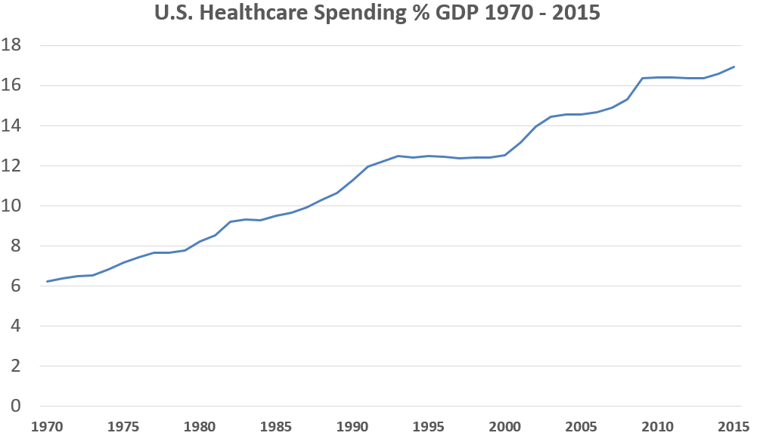
U.S. Healthcare Costs: Historical Trend
U.S. healthcare costs have risen consistently relative to the size of the economy (% GDP).
Rapid economic growth slowed this trend in the 1990’s, as did a lower rate of cost increases following the Great Recession of 2007-2009.
During 2015:
Per capita national health expenditures were $10,000, with total expenditures of $3.2 trillion or 17.8% GDP.
17.8%
Source: CDC National Center for Health Statistics / FastStats; OECD Health Statistics
Notes:
One of the challenges with such high costs is people can’t afford insurance.

Slide 9
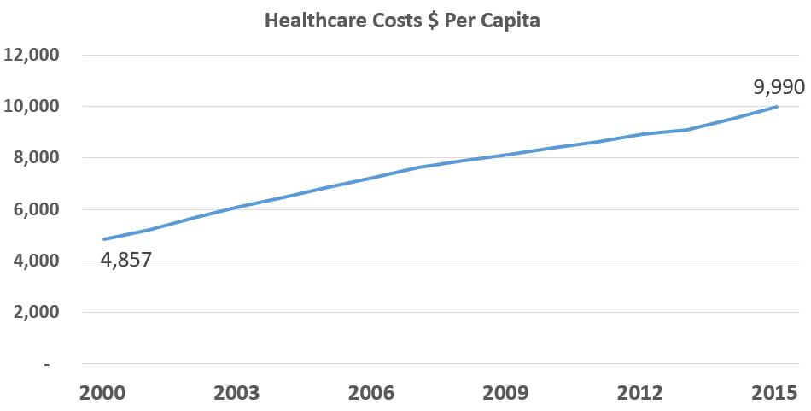
U.S. Healthcare Costs
Per Capita Expenditures $10,000 in 2015
5% annual growth rate 2000-2015
Total Cost Increases:
73% due to rate
27% volume
Sources: CDC National Center for Health Statistics / FastStats; OECD Health Statistics
BEA: Introducing the New BEA Health Care Satellite Account (January 2015)

Slide 10
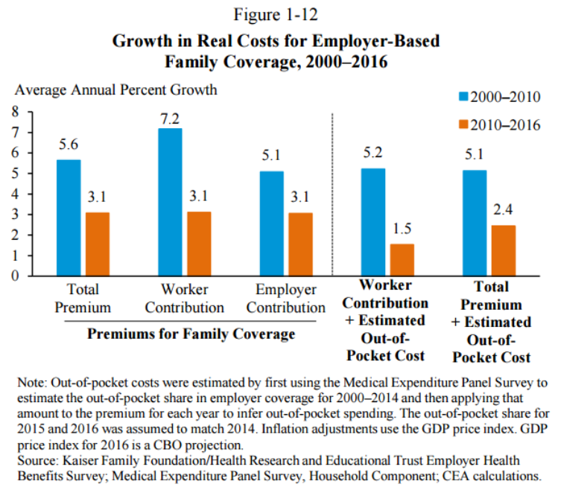
Health Insurance Costs: Employer Market (155m)
Health insurance premiums used to go up 5.6% per year; now they go up 3.1% per year.
Total out-of-pocket costs used to go up 5.1% per year; now they go up 2.4%.
Source: 2017 Economic Report of the President

Slide 11
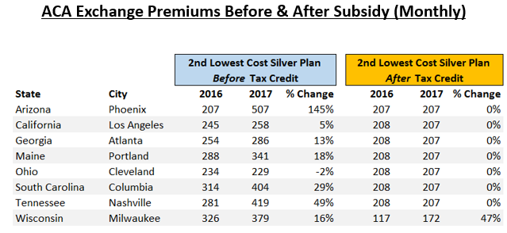
ACA Subsidies Rise with Premium Costs (12m)
40-year old non-smoker / $30,000 income
8.7 million people (84% of all marketplace enrollees) received premiums subsidies (tax credits) in 2017.
Source: Kaiser Family Foundation - “2017 Premium Changes and Insurer Participation in the ACA’s Health Insurance Marketplaces” (October 2016) and
“Counties at Risk of Having No Insurer in 2018” (June 2017)

Slide 12
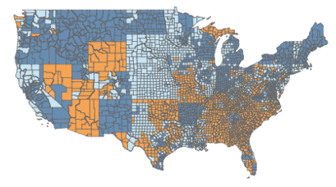
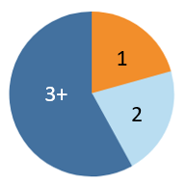
Insurer Participation
No Obamacare Option for 2018
2 out of 3,143 (0.1%) counties
381 persons, vs. 12,215,980 estimated enrollees
Average Number of Insurers by State
2014 5.0
2015 6.0
2016 5.6
2017 4.3
Insurer Choices
In 2017, 58% of enrollees had a choice of 3+ insurers, vs. 85% in 2016
Number of Insurers by County (2017)
21%
58%
21%
Kaiser Family Foundation: Counties at Risk of Having No Insurer on the Marketplace (Exchange) in 2018 (August 15, 2017) and
Insurer Participation on ACA Marketplaces, 2014-2017 (June 1, 2017)

Slide 13
CBO: Exchanges are Stable under Current Law (Obamacare)
CBO, March 2017:
“Under current law, most subsidized enrollees purchasing health insurance coverage in the nongroup market [Obamacare exchanges] are largely insulated from increases in premiums because their out-of-pocket payments for premiums are based on a percentage of their income; the government pays the difference.”
“The subsidies to purchase coverage combined with the penalties paid by uninsured people stemming from the individual mandate are anticipated to cause sufficient demand for insurance…for the market to be stable.”
CBO: “American Health Care Act” (March 13, 2017)

Slide 14
Healthcare Reform
Current State
Sabotage Efforts
Republican Legislative Proposals
Short-term Fixes
Long-term Fixes

Slide 15
Sabotage Efforts
Limit Medicaid expansion
Limit mandate enforcement (IRS)
Eliminate mandates & premium subsidies
Attack the Structure
Reduce Funding
Slow Enrollment
Comm / PR
Threaten cost-sharing reduction subsidies
Eliminate co-op / risk-corridor funding
Claim exchange is in a “death spiral”
Negative PR campaign
Reduce enrollment consulting support & advertising
Prior year sabotage
Ongoing sabotage
Failed attempt
NYT-Thomas Edsall “Killing Obamacare Softly” (July 27, 2017) NYT-Abbe Gluck “How the GOP Sabotaged Obamacare” (May 25, 2017) Washington Post-Dana Milbank “The GOP Masterminds behind the Obamacare Sabotage” (March 14, 2017)
Notes:
Added a key in lower right; altered the bullets to show status

Slide 16
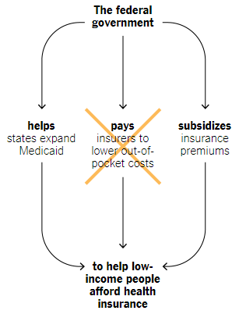
Sabotaging Cost-Sharing Reduction (CSR) Payments (1 of 2)
What are CSR Payments?
Insurers lower cost-sharing (deductibles and co-pays) for lower-income persons in exchange for govt. payments
~6 million people, 57% of all marketplace enrollees, benefit
CBO estimates the cost of these payments at $7 billion in fiscal year 2017, rising to $16 billion by 2027
Sabotage Approach
U.S. House of Representatives sued Dpt. of HHS, challenging the legality of making the cost-sharing reduction (CSR) payments without an explicit appropriation
A district court judge has ruled in favor of the House; ruling appealed and payments continue month-to-month pending resolution
President Trump has threatened to stop making payments
NYT “Trump Threat to Obamacare Would Send Premiums and Deficits Higher”
Kaiser Family Foundation “The Effects of Ending the ACA’s Cost Sharing Reduction Payments” (April 2017)
CBO “The Effects of Terminating Payments for Cost-Sharing Reductions” (August 2017)

Slide 17
Sabotaging Cost-Sharing Reduction (CSR) Payments (2 of 2)
Consequences if CSR Payments Stopped
Insurers would raise silver premiums by about 20-25% (pre-subsidy)
Since premiums go up, subsidies go up…CBO estimates deficit increase of nearly $200B over 10 years (~2%)
Both subsidy per person and number of persons receiving subsidies would rise
Number of uninsured may decline by 1m after 2020, as more would get subsidies (200-400% FPL group)
Exchanges would still be stable / no “death spiral”
NYT “Trump Threat to Obamacare Would Send Premiums and Deficits Higher”
Kaiser Family Foundation “The Effects of Ending the ACA’s Cost Sharing Reduction Payments” (April 2017)
CBO “The Effects of Terminating Payments for Cost-Sharing Reductions” (August 2017)

Slide 18
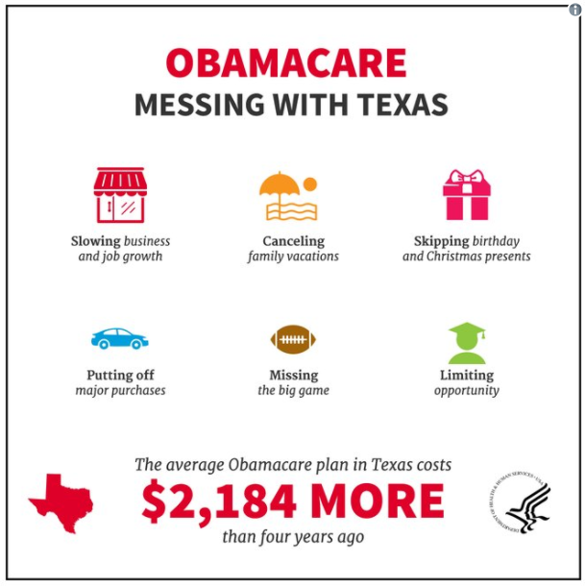
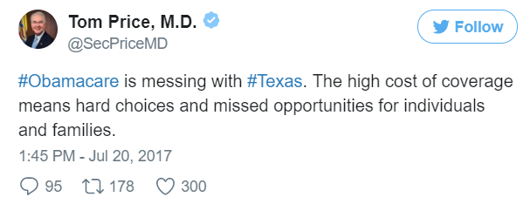
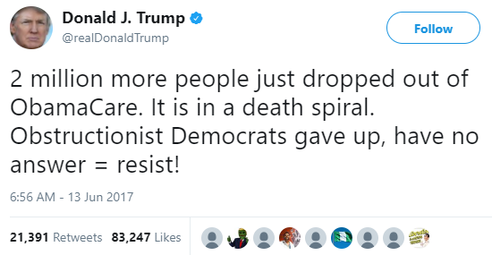
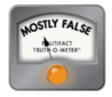
Sabotaging the ACA
Tom Price is the Secretary of HHS!
NYT-Thomas Edsall “Killing Obamacare Softly” (July 27, 2017)
Politifact: Donald Trump’s Mostly False Tweet About Obamacare Dropouts (June 14, 2017)

Slide 19
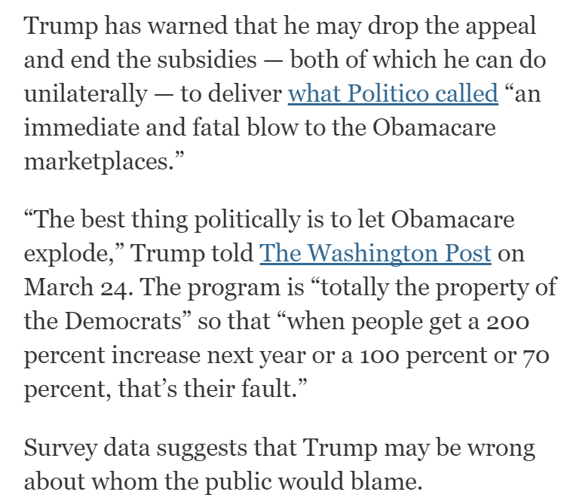
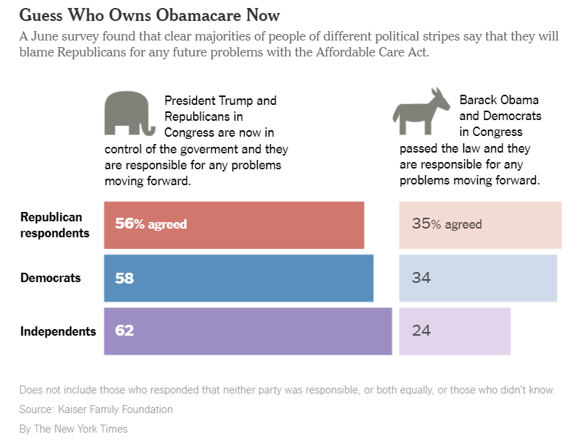
Opinion & Polling: You Sabotage It, You Own It (?)
NYT, Edsall:
NYT-Thomas Edsall “Killing Obamacare Softly” (July 27, 2017)

Slide 20
Healthcare Reform
Current State
Sabotage Efforts
Republican Legislative Proposals
Short-term Fixes
Long-term Fixes

Slide 21
Republican Proposals Summary
Bill | Increase in Uninsured (millions) 2018 | Increase in Uninsured (millions) 2026 | Debt Reduction $ Billions (10 years) | Deficit Reduction % (10 years)*
AHCA (House) | 14 | 24 | -119 | 1.3%
BCRA (Senate) | 15 | 22 | -321 | 3.4%
ORRA (Senate Partial Repeal) | 17 | 32 | -473 | 5.0%
HCFA (Senate Skinny Repeal) | 15 | 16 | -184 | 2.0%
Sources: CBO reports for the legislation indicated.
*CBO January 2017 baseline includes $9,426 billion in total debt (sum of deficits) over 10 years. This is the denominator in the deficit reduction % equation. Note this is not % GDP.
Notes:
Large cuts in Medicaid reduce deficit more than tax cuts increase it
Not much % reduction

Slide 22
Healthcare Reform
Current State
Sabotage Efforts
Republican Legislative Proposals
Short-term Fixes
Long-term Fixes

Slide 23
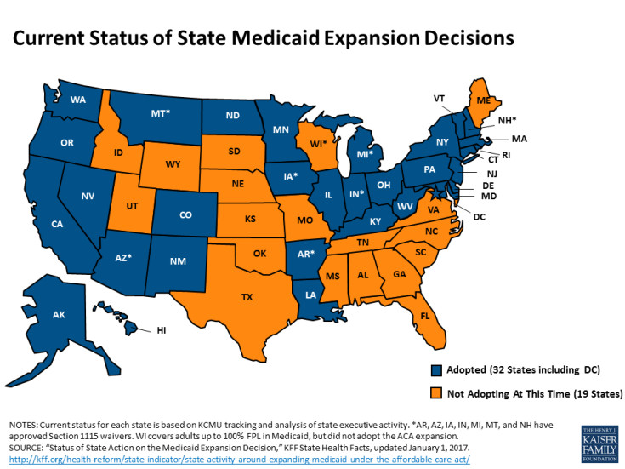
Expand Medicaid in Remaining 19 States
31 states plus DC have adopted the Medicaid expansion, covering 11m
19 states have not; estimated 4.5m could gain coverage
VOX – Sarah Kliff - There are 28 million uninsured under Obamacare. Here’s who they are. (June 29, 2017)

Slide 24
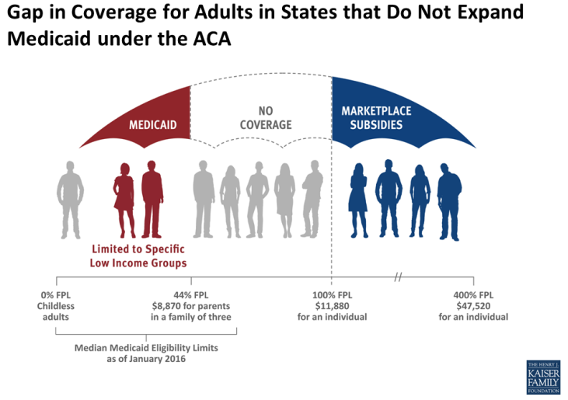
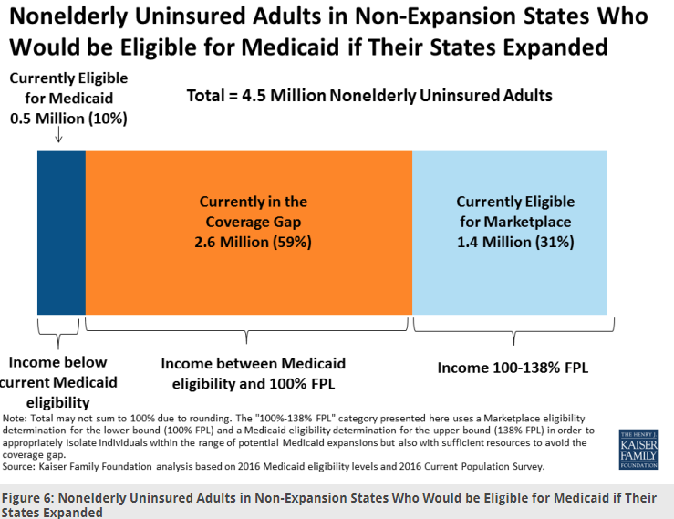
Expanding Medicaid to Remaining 19 States Could Cover 4.5 Million
Kaiser Family Foundation: “The Coverage Gap: Uninsured Poor Adults in States that Do Not Expand Medicaid” (October 2016)

Slide 25
Bi-Partisan House “Problem Solvers” Proposals
Make the cost-sharing reduction (CSR) payments to insurers ($8B)
Dedicated stability fund for states to lower premiums and limit insurer losses by covering their most expensive patients
Exempt more small businesses from the employer mandate; lift requirement to provide insurance or pay a tax to 500 employees vs. 50 today
Repeal the Medical Device Tax
Set guidelines for insurers to sell across state lines (ACA technically allows already). Major hurdle is setting up networks spanning multiple states.
Note: The caucus is 40 members of the House, both Democrat and Republican, co-chaired by Tom Reed (R-NY) and Josh Gottheimer (D-NJ)
Source: VOX – Jeff Stein – The new bipartisan House proposal to fix Obamacare, explained (July 31, 2017)

Slide 26
Other Ideas for Strengthening ACA
Expand Medicaid to in remaining 19 states (state-level decision)
Increase subsidies (currently ~$40B/year for 10 million persons)
Expand subsidies above 400% of poverty
Fund risk corridors / re-insurance
Public option (Medicaid?) on exchanges (where few insurers or to assist persons with variable low-income)
Enforce mandates (both employer and individual)
Aggressive ACA enrollment support programs (advertising, assistance)
Employer subsidies for hiring persons over 50, to address discrimination

Slide 27
Healthcare Reform
Current State
Sabotage Efforts
Republican Legislative Proposals
Short-term Fixes
Long-term Fixes

Slide 28
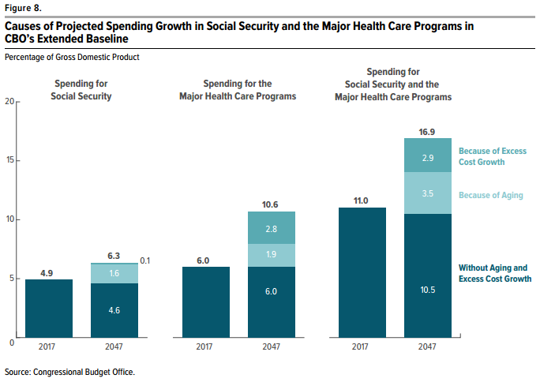
Healthcare Impact on Federal Budget: “Unsustainable”
Costs for major healthcare programs will go up by 4.6% GDP over the next 30 years.
Historically, the budget deficit is about 3% GDP.
“Excess cost growth” represents the extent to which the growth rate of healthcare spending per capita exceeds the growth rate of potential GDP per capita.”
2.8% GDP of the 4.6% GDP increase from 2017-2047 is due to excess cost growth.
Source: CBO Long Term Budget Outlook (March 2017)
Notes:
Why are changes essential?

Slide 29
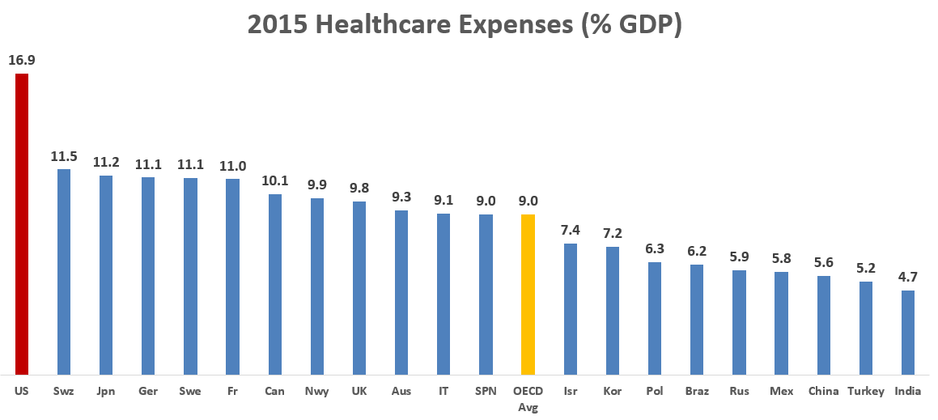
U.S. Healthcare Costs are High Relative to Other Countries
U.S. spends about 5% GDP more than the next most expensive country
Gap is $1 trillion per year or $3,000/person
Source: OECD Health Statistics 2016
http://stats.oecd.org/Index.aspx?DataSetCode=SHA

Slide 30
Three Models of European Coverage
Element | 1. Govt. Insurance Plan, Public Delivery | 2. Govt. Insurance Plan, Private Delivery | 3. Regulated Private System
U.S. Analogy | Veterans Administration | Medicare | Private Insurance Companies
Single Payer? | Yes | Yes | No
Government provides insurance? | Yes | Yes | Private (More Subsidies)
Doctors’ Employer | Government | Private | Private
Hospital mgmt. | Government | Private | Private
Insurance | Government | Government | Private (Stronger mandate)
Countries | Britain, Italy, Spain, Sweden | Canada, France Germany* | Netherlands Switzerland
Source: The Economist “The fix for American health care can be found in Europe” (August 14, 2017)
*Germany is a blend of 2 & 3
Notes:
So why are costs higher? First, let’s look at what other countries do…
Is Germany “Single Payer?” DD: Clarified Germany is a blend of 2 and 3 (added #). For higher income folks, private options available.
Not sure I understand this chart. DD: Helps clarify that there is more than one way to get to universal coverage used in Europe.

Slide 31
Many Reasons Why U.S. Costs Are Higher vs. Other Countries
Obesity and related chronic conditions
Fee for service vs. outcome, resulting in over-utilization
Higher compensation of Medical professionals vs. other countries
Shortage of doctors and nurses
Private Incentives & Behavior
Culture
Government and Taxation
Process & Technology
Tolerance for rationing by price vs. government-mandated inclusion
Expectations for heroic intervention at end-of-life
High cost concentration
Higher per-capita income
Private insurance overhead & profits
Number and use of MRI machines
Decentralized payment and delivery IT systems
Process variation; significant delivery cost differences by region
Tax exemption / subsidy for employer-based healthcare
No Medicare budget limits
Medicare fraud
Defensive medicine / Tort
Higher Pharma costs
PBS: “Why does healthcare cost so much in America? Ask Harvard’s David Cutler” (November 2013)
Forbes: Todd Hixon “Why are U.S. Healthcare Costs So High?” (March 2012)
Source: The Atlantic: Victor R. Fuchs “Why Do Other Rich Nations Spend So Much Less on Healthcare?” (July 2014)

Slide 32
Cost Reduction Ideas
1.
Admin Costs
2.
Cost Variation
3.
Obesity
4.
Fraud
5.
Drug Costs
6.
Defensive Medicine
Estimated Cost Savings (Annual)
Admin Costs $350B
Cost Variation $200B
Obesity $ 60B
Fraud $ 60B
Drug Costs $ 50B
Def Medicine $ 30B
$750B
Approximately $1 trillion savings required to match next most expensive country.

Slide 33
1. Administrative Costs / Single Payer
About 25% of healthcare costs associated with administration
Other countries at 10-15%
Duke University has 900 hospital beds and 1,300 billing clerks
$3,500B healthcare spending per year x (25% - 15%) = $350B potential savings
Price-Waterhouse study estimated savings at $210B on unnecessary billing & administrative costs (2009)
Much of this savings is jobs, so there would be an offset with unemployment and transitional costs (retraining)
Long-run, savings in healthcare represents demand in other industries, creating jobs there
Sources:
Physicians for a National Health Program “Beyond the Affordable Care Act: A Physicians’ Proposal for Single‐Payer Health Care Reform”
James E. Dalen MD - American Journal of Medicine – “We Can Reduce U.S. Healthcare Costs” (March 2010)

Slide 34
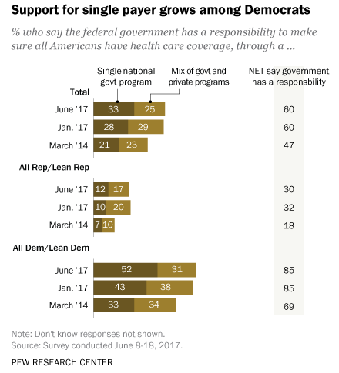
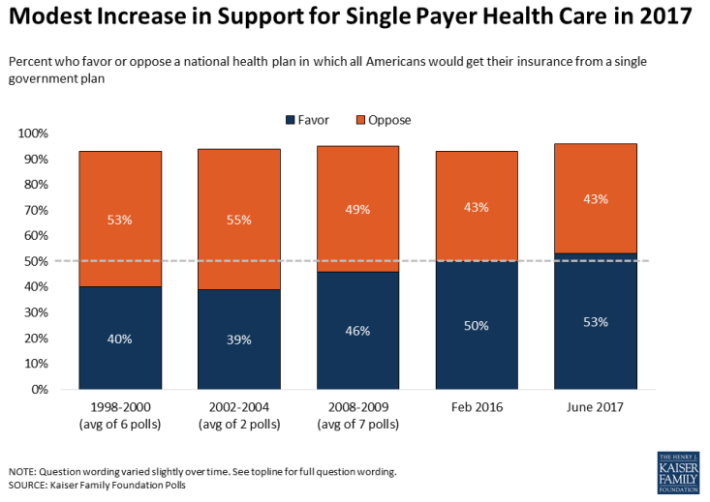
1a. Polling: Single Payer / Medicare For All
Pew Center: “Public support for ‘single payer’ health coverage grows, driven by Democrats” (June 2017)
Kaiser Family Foundation: “Modestly Strong but Malleable Support for Single-Payer Health Care” (July 2017)

Slide 35
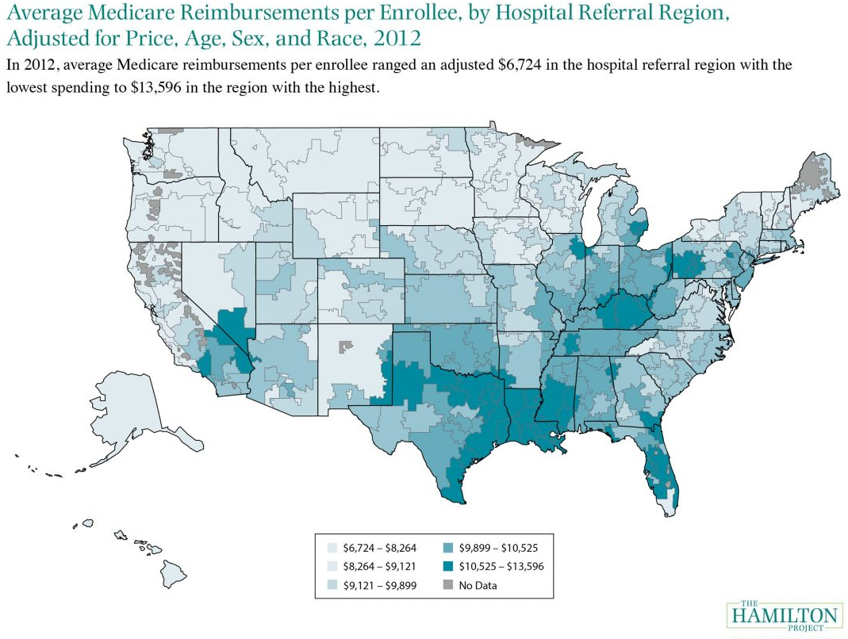
2. Cost Variation
Roughly 33% of healthcare spending ($1 trillion per year) is not associated with improved outcomes.
If 20% of this variation can be eliminated, savings potential $200B/year
Insurance companies should charge more for unnecessary services (i.e., beyond what the literature says is necessary.)
Demand side: Higher co-payment is a good way to steer “shoppers” to less expensive providers of given service.
Supply side: Pay for outcome (capped amount by ailment) vs. “fee for service.”
Palliative care vs. heroic intervention
PBS: “Why does healthcare cost so much in America? Ask Harvard’s David Cutler” (November 2013)
James E. Dalen MD - American Journal of Medicine – “We Can Reduce U.S. Healthcare Costs” (March 2010)

Slide 36
2a. Higher Costs: Price, Volume and Mix
Category | Share of 2014 Spend
Hospital Care | 32%
Physician and Clinical services | 20%
Prescription Drugs | 10%
Total Share | 62%
Cost of physicians per capita is 5x peer countries
Price: Specialist doctors charge 3-6x
Mix: Higher proportion of visits to specialists
Higher per-procedure rates
MRI costs $1,080 in U.S. and $280 in France
Higher income per-capita correlated with higher consumption (units of healthcare)
3x mammograms, 2.5x MRI scans, 31% more C-sections
Source: CDC National Center for Health Statistics / FastStats (2014)
Forbes: Todd Hixon “Why are U.S. Healthcare Costs So High?” (March 2012)
Washington Post: Ezra Klein – “Why an MRI Costs… ”(August 2011)
The Atlantic: “Why do other rich nations spend so much less on healthcare?” (July 2014)

Slide 37
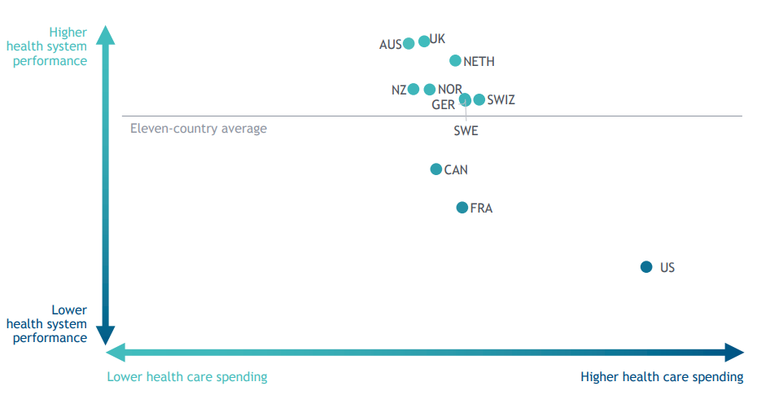
2b. Relative Cost and Performance
Performance reflects:
Care process (#5)
Access (#11)
Admin efficiency (#10)
Equity (#11)
Healthcare outcomes (#11)
Source: Commonwealth Fund “International Comparison Reflects Flaws and Opportunities for Better U.S. Healthcare” (July 2017)

Slide 38
3. Fraud & 4. Obesity
3. Healthcare Fraudulent Payments
$110B cited in 2010 by Obama Administration
Set target to cut this roughly in half
More auditors and enforcement resources
More severe penalties
4. Obesity
Estimated $150-210 billion / year
Reducing obesity rates by 30% would save ~$60B/year
Taxes on non-nutritious foods and higher healthcare premiums for obese
Obama Whitehouse Archives: Improper Payments Elimination and Recovery Act: Cutting Waste and Fraud in Government (July 22, 2010)
CDC “Adult Obesity Causes & Consequences” (2008)
The State of Obesity: Healthcare Costs of Obesity (Cites 2008 and 2012 studies)
Notes:
Updated for lower figures; removed the article citing a much higher figure

Slide 39
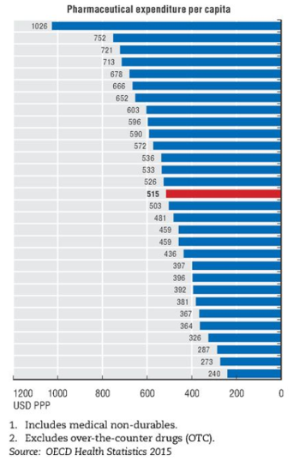
5. Allow Medicare to Negotiate Drug Costs
CBO
$145B over 10 years (maybe)
Allow Medicare to negotiate drug prices
Require manufacturers to pay a rebate to the federal government for brand name drugs sold to Medicare Part D (LIS enrollees only; about 30% of enrollees).
As under Medicaid, the rebate would be at least 23.1 percent of the drug’s average manufacturer price (AMP)
Other Source (Dalen-AJM)
Other countries pay 20-40% less for drugs
If drug costs are 10% of overall spending: ($3,500B x 10% x 30% savings = $105B per year)
U.S. at $1,026 / person
vs. $515 for OECD
Source: CBO “Options for Reducing the Deficit 2017-2026” Chapter 5 (December 2016)
Kaiser Family Foundation “Searching for Savings in Medicare Drug Price Negotiations”
James E. Dalen MD - American Journal of Medicine – “We Can Reduce U.S. Healthcare Costs” (March 2010)

Slide 40
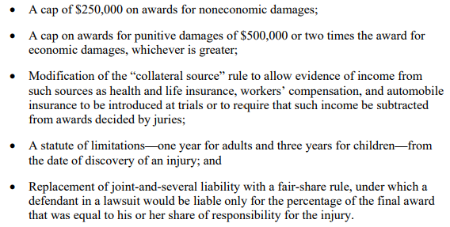
6. Defensive Medicine / Tort Reform
CBO: Effects
CBO: Policy Changes
Reduce healthcare spending by 0.5% or ~$20B per year
Reduce budget deficit by $64B total over 10 years ($6B / year)
Curb defensive medicine; providers would order fewer tests and procedures
Lower malpractice insurance premiums
Many states have already implemented tort reform
Source: CBO – Analysis of the Effects of Proposals to Limit Costs Related to Medical Malpractice (Tort Reform) – October 9, 2009
Source: CBO – Analysis of the President’s 2018 Budget (July 2017)
James E. Dalen MD - American Journal of Medicine – “We Can Reduce U.S. Healthcare Costs” (March 2010)

Slide 41
Conclusions
ACA has dramatically expanded coverage by about 20 million people
About 27 million remain uninsured
There are proven methods for expanding coverage further (Medicaid expansion)
ACA opponents have an active sabotage campaign underway
U.S. healthcare is the most expensive in the world by far
Other countries have figured out how to deliver quality care at 50% - 75% the cost
There are many known areas to explore for savings
A National Commission on Healthcare Reform could organize improvement efforts

Slide 42
What You Can Do: Politicians to Contact
Problem Solvers Caucus
Local Contact
US Rep Dan Lipinksi (D-IL 3rd) at 773-948-6223
2346 Rayburn HOB
Washington DC, 20515
Lead Senators
Senator Lamar Alexander (R-TN)
Senator Patty Murray (D-WA)
Send Rep Lipinski your best ideas or support

